Slide 1
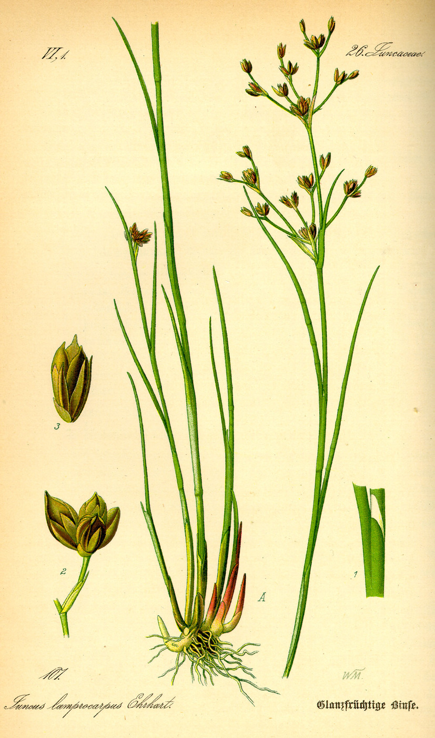
AN ILLUSTRATED STUDY ATLAS
The language of graminoids
Grasses, sedges and rushes
of the southeastern United States
A visual companion for learning the terminology used in Weakley’s flora
Labeled examples, comparison plates, practice questions and a term index
01
Notes:
An independent educational study aid. The illustrations show selected examples and schematic character states, not diagnostic portraits of every southeastern species. Definitions cover the complete preceding glossary. Some historical plates and nonregional specimens illustrate shared structures. Generated comparison plates show schematic forms and do not establish species identity.
Illustration sources and attribution
Core references
https://ncbg.unc.edu/research/unc-herbarium/floras/
https://www.iplant.cn/foc/pdf/Poaceae.pdf
https://herbarium.ncsu.edu/rare/carex.htm
https://herbarium.ncsu.edu/rushes/
https://vplants.org/portal/plants/glossary/index.php

Slide 2
A study route through the deck
Plant form
Stems, leaf junctions, growth and orientation
Flowering clusters
Branches, stalks, spikes and panicles
Grasses and flowers
Spikelets, florets, awns and reproductive organs
Sedges and rushes
Perigynia, achenes, tepals and capsules
Shapes and surfaces
Outlines, tips, hairs and textures
Reading and recall
Key notation, practice and alphabetical index
02
Notes:
Study one section at a time. Cover a label or definition and name the structure aloud. Then inspect the corresponding part on a mature specimen. Sources and image credits accompany each relevant slide in its notes.
Illustration sources and attribution
Core references
https://ncbg.unc.edu/research/unc-herbarium/floras/
https://www.iplant.cn/foc/pdf/Poaceae.pdf
https://herbarium.ncsu.edu/rare/carex.htm
https://herbarium.ncsu.edu/rushes/
https://vplants.org/portal/plants/glossary/index.php

Slide 3
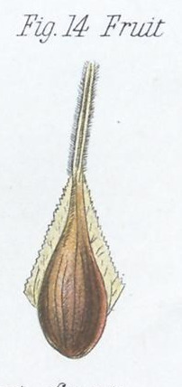
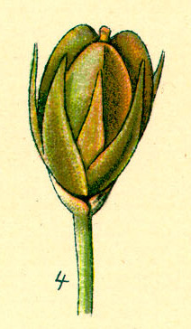
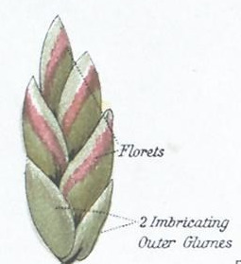
PLANT FORM
Meet the graminoids
Graminoid A grasslike plant; the main families studied here are grasses, sedges, and rushes.
Poaceae The grass family; flowers are organized into spikelets containing florets.
Cyperaceae The sedge family; individual flowers are subtended by scales and typically produce achenes.
Juncaceae The rush family; its usually small flowers have six tepals and produce capsules.
Grass: spikelets and florets
Carex sedge: perigynium around an achene
Capsule surrounded by tepals
Grasslike appearance is a starting point. Flower and fruit structure separate the families.
03
Notes:
Graminoid: A grasslike plant; the main families studied here are grasses, sedges, and rushes. Poaceae: The grass family; flowers are organized into spikelets containing florets. Cyperaceae: The sedge family; individual flowers are subtended by scales and typically produce achenes. Juncaceae: The rush family; its usually small flowers have six tepals and produce capsules. Teaching notes
Grasslike appearance is a starting point. Flower and fruit structure separate the families.
Illustration sources and attribution
D. M’Alpine, The Botanical Atlas (1882), Plate IV. Public domain, via BHL / Wikimedia Commons.
D. M’Alpine, The Botanical Atlas (1882), Plate IV. Public domain, via BHL / Wikimedia Commons.
Otto Wilhelm Thomé (1885), Flora von Deutschland. Public domain, via Wikimedia Commons.
https://commons.wikimedia.org/wiki/File:Juncus_spp_107.jpg
Core references
https://ncbg.unc.edu/research/unc-herbarium/floras/
https://www.iplant.cn/foc/pdf/Poaceae.pdf
https://herbarium.ncsu.edu/rare/carex.htm
https://herbarium.ncsu.edu/rushes/
https://vplants.org/portal/plants/glossary/index.php

Slide 4
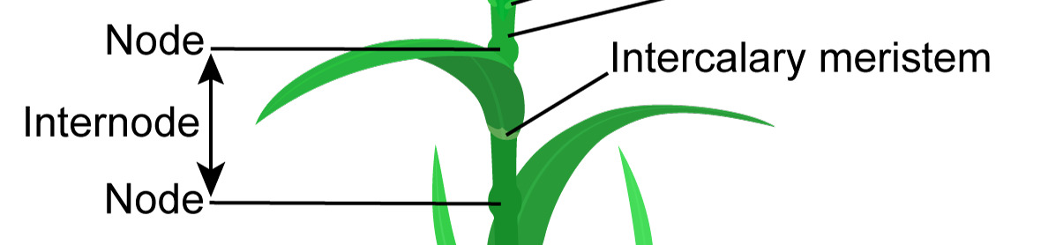
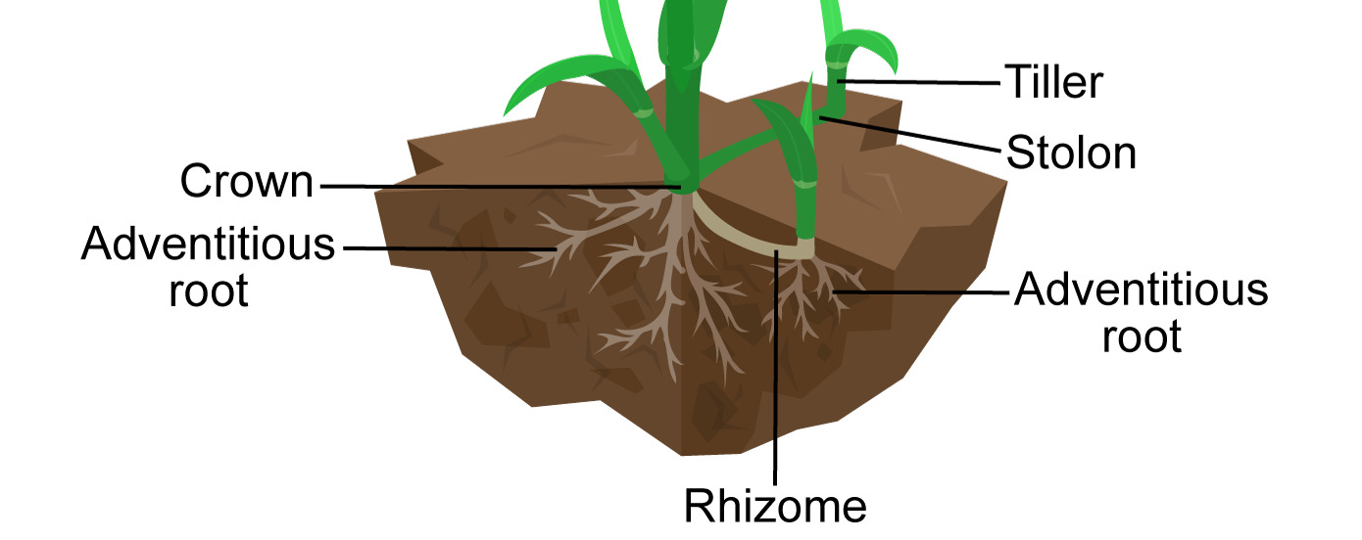
PLANT FORM
A grass plant from the ground up
Culm The stem of a grass, sedge, or rush.
Node A point on the stem where a leaf or branch attaches.
Internode The stem segment between two nodes.
Crown The compact basal region from which roots and shoots arise.
Nodes mark leaf attachment; an internode is the culm segment between successive nodes.
Tiller A shoot arising near the base of a grass plant.
Innovation A new vegetative shoot, especially in descriptions of perennial grasses.
Crown, tiller, stolon, rhizome and adventitious roots: trace each shoot to its point of origin.
A node marks leaf attachment. A tiller is a new basal shoot.
04
Notes:
Culm: The stem of a grass, sedge, or rush. Node: A point on the stem where a leaf or branch attaches. Internode: The stem segment between two nodes. Crown: The compact basal region from which roots and shoots arise. Tiller: A shoot arising near the base of a grass plant. Innovation: A new vegetative shoot, especially in descriptions of perennial grasses. Teaching notes
A node marks leaf attachment. A tiller is a new basal shoot.
Illustration sources and attribution
Kelvinsong, CC BY 3.0; adapted by Paleontological Research Institution / Earth@Home. Cropped from the provided image. https://evolution.earthathome.org/grasses/morphology/ — https://creativecommons.org/licenses/by/3.0/
https://evolution.earthathome.org/grasses/morphology/
Both node labels and the internode bracket are retained. Intercalary meristem label is also retained. Stem and leaves naturally continue beyond crop edges.
Kelvinsong, CC BY 3.0; adapted by Paleontological Research Institution / Earth@Home. Cropped from the provided image. https://evolution.earthathome.org/grasses/morphology/ — https://creativecommons.org/licenses/by/3.0/
https://evolution.earthathome.org/grasses/morphology/
All basal labels retained. The main stem and one basal leaf continue beyond the upper crop edge. Illustration is schematic.
Core references
https://ncbg.unc.edu/research/unc-herbarium/floras/
https://www.iplant.cn/foc/pdf/Poaceae.pdf
https://herbarium.ncsu.edu/rare/carex.htm
https://herbarium.ncsu.edu/rushes/
https://vplants.org/portal/plants/glossary/index.php

Slide 5
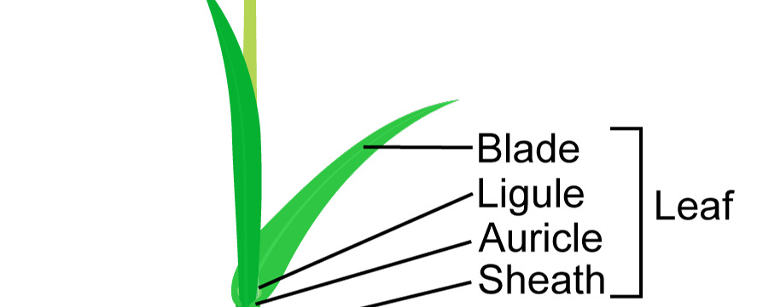
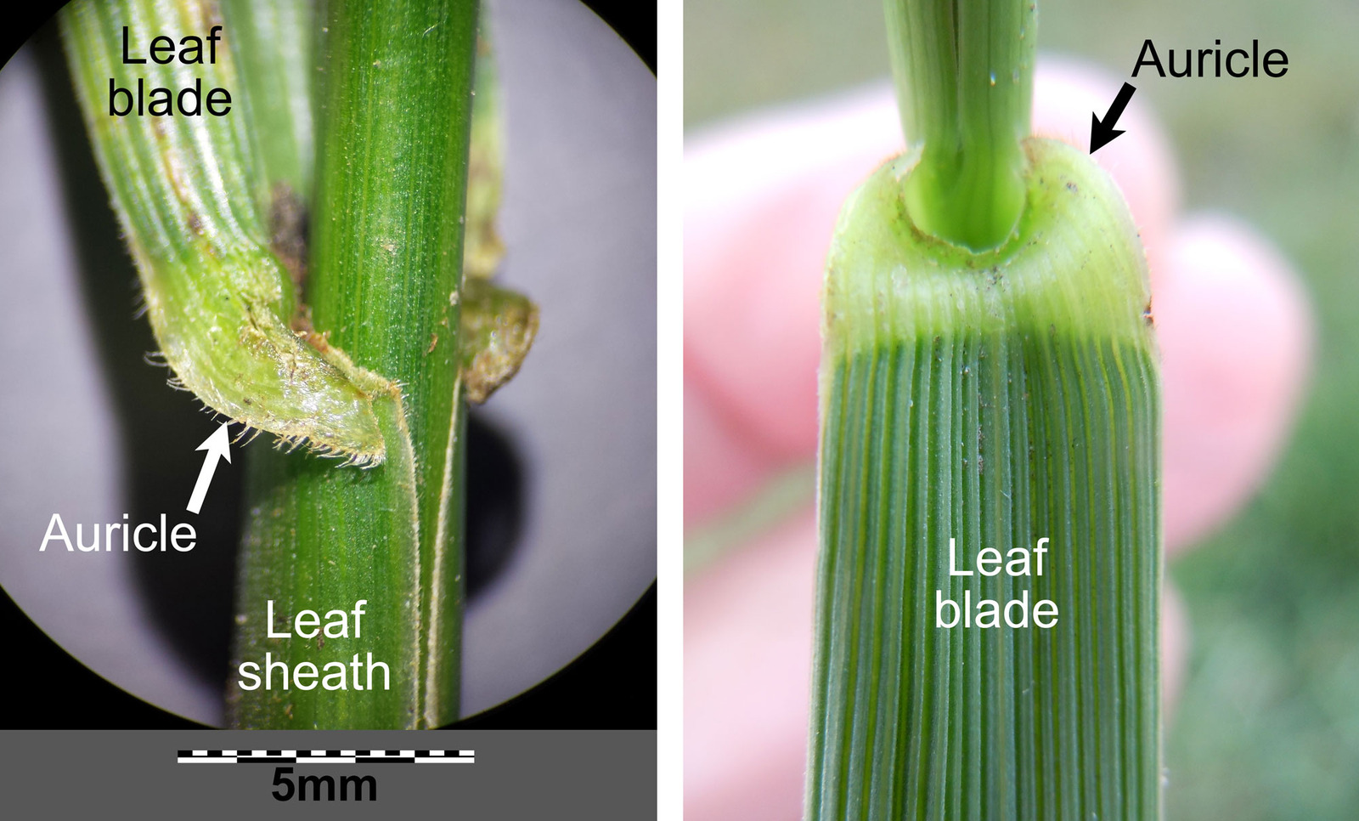
PLANT FORM
The blade–sheath junction
Blade / lamina The free, usually elongated part of a leaf.
Sheath The basal leaf portion that surrounds the stem.
Ligule A flap or fringe of hairs at the inner junction of blade and sheath.
Collar The band on the outside of a grass leaf where blade and sheath meet.
The leaf comprises blade and sheath; inspect their junction for a ligule and auricles.
Auricle A small ear-shaped projection, often at the blade–sheath junction.
Auricles at the blade–sheath junction
The collar is the outer junction. The ligule sits on the inner side.
05
Notes:
Blade / lamina: The free, usually elongated part of a leaf. Sheath: The basal leaf portion that surrounds the stem. Ligule: A flap or fringe of hairs at the inner junction of blade and sheath. Collar: The band on the outside of a grass leaf where blade and sheath meet. Auricle: A small ear-shaped projection, often at the blade–sheath junction. Teaching notes
The collar is the outer junction. The ligule sits on the inner side.
Illustration sources and attribution
Kelvinsong, CC BY 3.0; adapted by Paleontological Research Institution / Earth@Home. Cropped from the provided image. https://evolution.earthathome.org/grasses/morphology/ — https://creativecommons.org/licenses/by/3.0/
https://evolution.earthathome.org/grasses/morphology/
Retains Blade, Ligule, Auricle, Sheath and Leaf labels; enlarged schematic junction, not a dissected close-up.
Stefan.Iefnaer and Tim1357. CC BY-SA 4.0 / 2.0. Adapted by PRI.
https://evolution.earthathome.org/grasses/morphology/
Core references
https://ncbg.unc.edu/research/unc-herbarium/floras/
https://www.iplant.cn/foc/pdf/Poaceae.pdf
https://herbarium.ncsu.edu/rare/carex.htm
https://herbarium.ncsu.edu/rushes/
https://vplants.org/portal/plants/glossary/index.php

Slide 6
PLANT FORM
Creeping stems and roots
Rhizome An underground stem bearing buds and usually reduced leaves.
Rhizomatous Having rhizomes.
Stolon A creeping stem at or near the ground surface, often rooting at its nodes.
Stoloniferous Producing stolons.
Fibrous roots Numerous relatively slender roots without a dominant taproot.
Crown, tiller, stolon, rhizome and adventitious roots: trace each shoot to its point of origin.
Trace creeping structures back to their nodes and buds to recognize stems.
06
Notes:
Rhizome: An underground stem bearing buds and usually reduced leaves. Rhizomatous: Having rhizomes. Stolon: A creeping stem at or near the ground surface, often rooting at its nodes. Stoloniferous: Producing stolons. Fibrous roots: Numerous relatively slender roots without a dominant taproot. Teaching notes
Trace creeping structures back to their nodes and buds to recognize stems.
Illustration sources and attribution
Kelvinsong, CC BY 3.0; adapted by Paleontological Research Institution / Earth@Home. Cropped from the provided image. https://evolution.earthathome.org/grasses/morphology/ — https://creativecommons.org/licenses/by/3.0/
https://evolution.earthathome.org/grasses/morphology/
All basal labels retained. The main stem and one basal leaf continue beyond the upper crop edge. Illustration is schematic.
Core references
https://ncbg.unc.edu/research/unc-herbarium/floras/
https://www.iplant.cn/foc/pdf/Poaceae.pdf
https://herbarium.ncsu.edu/rare/carex.htm
https://herbarium.ncsu.edu/rushes/
https://vplants.org/portal/plants/glossary/index.php

Slide 7
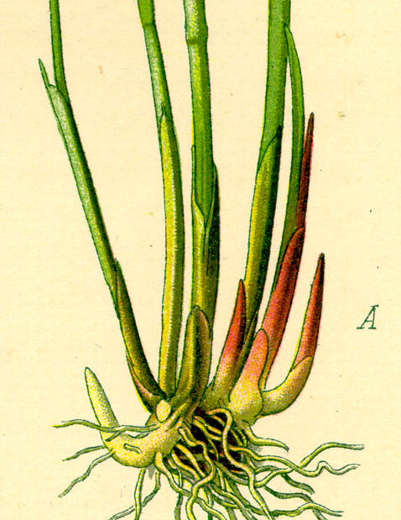
PLANT FORM
Habit and life history
Caespitose / cespitose Growing in a tuft or bunch.
Tussock A dense clump, sometimes raised above the surrounding ground.
Annual Completing its life cycle within one growing season.
Perennial Living for more than two years.
Vegetative Relating to leaves, stems, and roots rather than reproductive structures.
A tufted rush base
Growth form is visible in a specimen. Life span requires field or reference information.
07
Notes:
Caespitose / cespitose: Growing in a tuft or bunch. Tussock: A dense clump, sometimes raised above the surrounding ground. Annual: Completing its life cycle within one growing season. Perennial: Living for more than two years. Vegetative: Relating to leaves, stems, and roots rather than reproductive structures. Teaching notes
Growth form is visible in a specimen. Life span requires field or reference information.
Illustration sources and attribution
O. W. Thomé (1885). Public domain.
Core references
https://ncbg.unc.edu/research/unc-herbarium/floras/
https://www.iplant.cn/foc/pdf/Poaceae.pdf
https://herbarium.ncsu.edu/rare/carex.htm
https://herbarium.ncsu.edu/rushes/
https://vplants.org/portal/plants/glossary/index.php

Slide 8
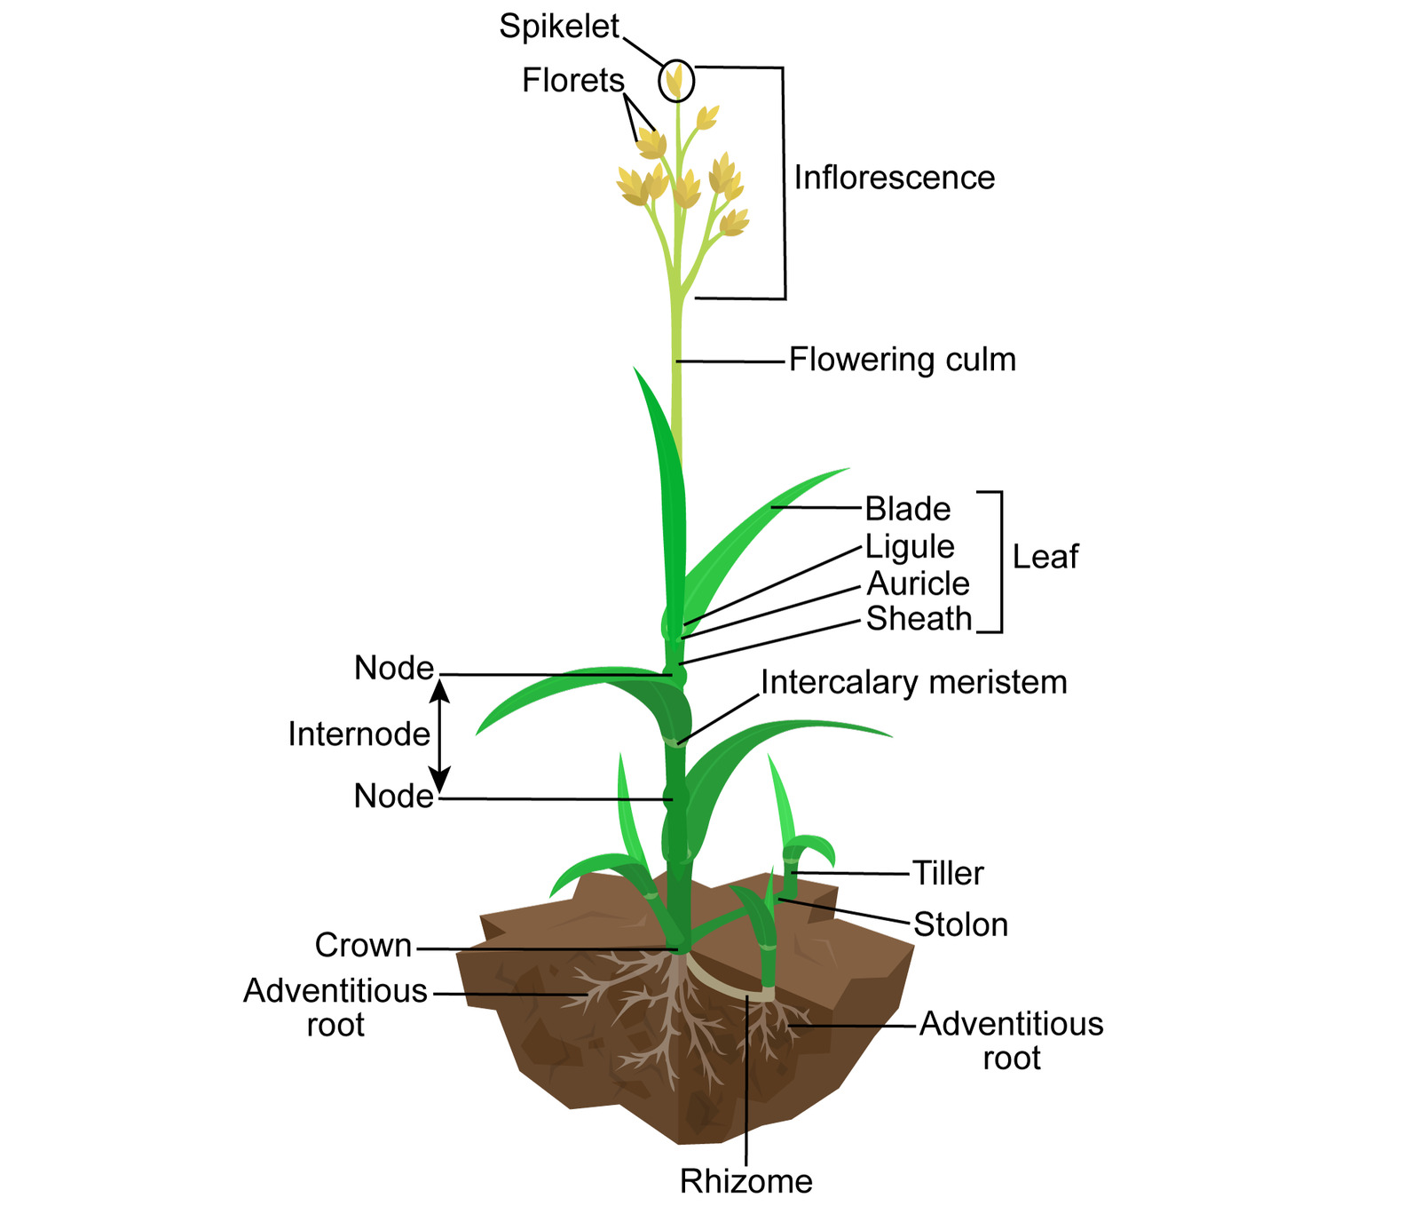
PLANT FORM
Reading positions on a plant
Basal At or near the base.
Cauline Borne along the stem; cauline leaves contrast with basal leaves.
Proximal Closer to the base or attachment point.
Distal Farther from the base or attachment point.
Terminal At the end of a stem or branch.
Lateral On the side.
Positions follow the plant’s axis
Proximal and distal stay the same when you rotate the specimen.
08
Notes:
Basal: At or near the base. Cauline: Borne along the stem; cauline leaves contrast with basal leaves. Proximal: Closer to the base or attachment point. Distal: Farther from the base or attachment point. Terminal: At the end of a stem or branch. Lateral: On the side. Teaching notes
Proximal and distal stay the same when you rotate the specimen.
Illustration sources and attribution
Kelvinsong, CC BY 3.0, adapted by PRI.
https://evolution.earthathome.org/grasses/morphology/
Core references
https://ncbg.unc.edu/research/unc-herbarium/floras/
https://www.iplant.cn/foc/pdf/Poaceae.pdf
https://herbarium.ncsu.edu/rare/carex.htm
https://herbarium.ncsu.edu/rushes/
https://vplants.org/portal/plants/glossary/index.php

Slide 9
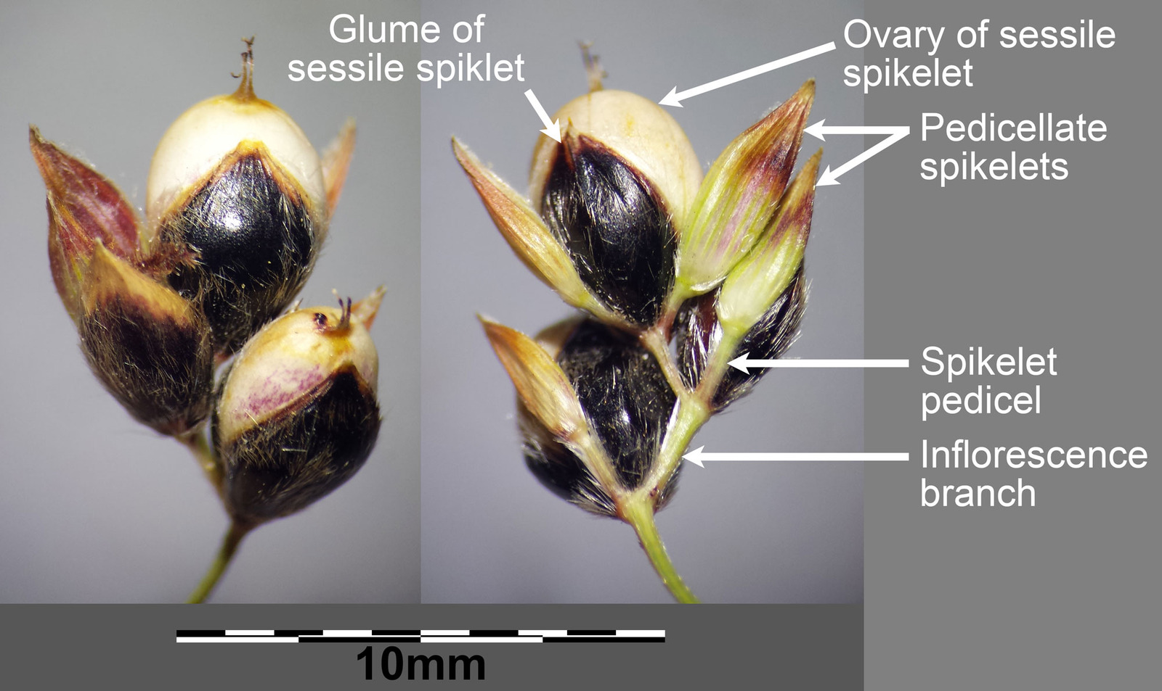
PLANT FORM
Faces, axils, and stalks
Adaxial Facing toward the parent axis; usually the upper face of a leaf blade.
Abaxial Facing away from the parent axis; usually the lower leaf face.
Axil The angle between a leaf or bract and the axis bearing it.
Axillary Arising in an axil.
The inner view shows the adaxial side
Subtending Situated immediately below a structure, as a bract beneath a flower.
Sessile Attached without a stalk.
Pedicellate / pedicelled Having a pedicel, or small stalk.
Sessile and stalked spikelets
The axil lies between a leaf or bract and the axis that bears it.
09
Notes:
Adaxial: Facing toward the parent axis; usually the upper face of a leaf blade. Abaxial: Facing away from the parent axis; usually the lower leaf face. Axil: The angle between a leaf or bract and the axis bearing it. Axillary: Arising in an axil. Subtending: Situated immediately below a structure, as a bract beneath a flower. Sessile: Attached without a stalk. Pedicellate / pedicelled: Having a pedicel, or small stalk. Teaching notes
The axil lies between a leaf or bract and the axis that bears it.
Illustration sources and attribution
Stefan.Iefnaer and Tim1357. CC BY-SA 4.0 / 2.0. Adapted by PRI.
https://evolution.earthathome.org/grasses/morphology/
Stefan.Iefnaer. CC BY-SA 4.0. Adapted by PRI.
https://evolution.earthathome.org/grasses/morphology/
Core references
https://ncbg.unc.edu/research/unc-herbarium/floras/
https://www.iplant.cn/foc/pdf/Poaceae.pdf
https://herbarium.ncsu.edu/rare/carex.htm
https://herbarium.ncsu.edu/rushes/
https://vplants.org/portal/plants/glossary/index.php

Slide 10
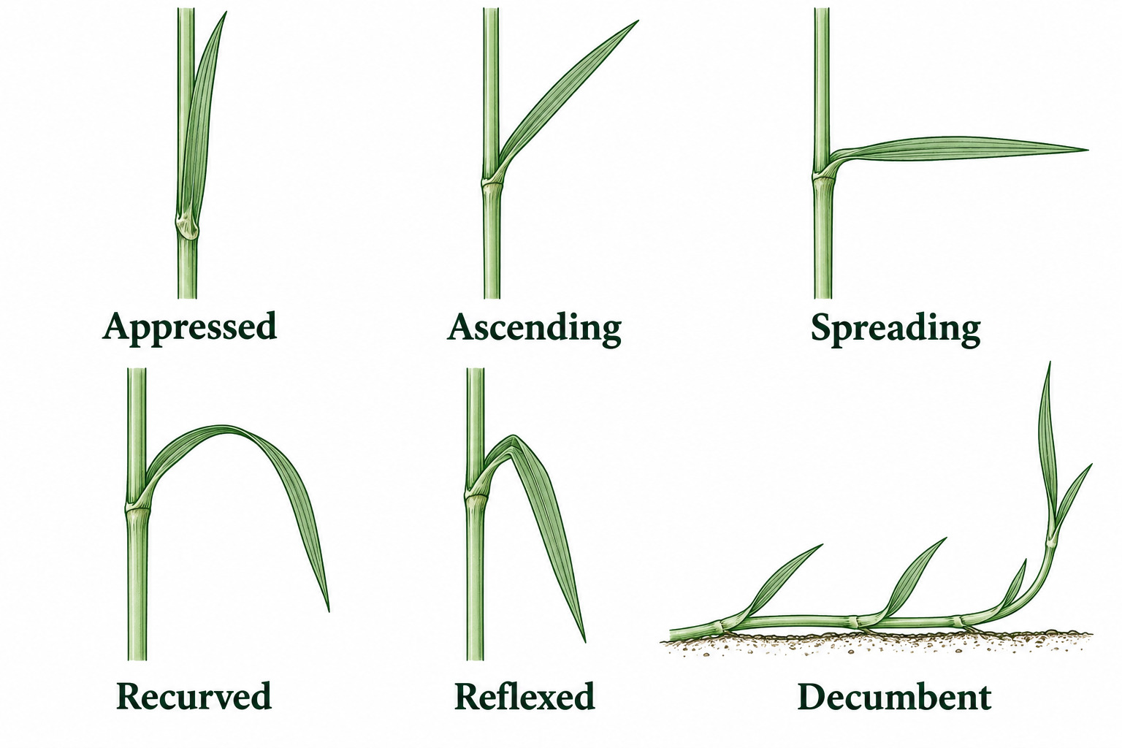
PLANT FORM
How structures stand or bend
Stipitate Supported on a short stalk called a stipe.
Appressed Lying closely against another structure.
Ascending Directed upward at an angle.
Spreading / divergent Extending outward from an axis.
Recurved Curved backward or downward.
Reflexed Bent sharply backward or downward.
Directions relative to the supporting axis
Stipitate describes a stalk. The other words describe orientation.
10
Notes:
Stipitate: Supported on a short stalk called a stipe. Appressed: Lying closely against another structure. Ascending: Directed upward at an angle. Spreading / divergent: Extending outward from an axis. Recurved: Curved backward or downward. Reflexed: Bent sharply backward or downward. Teaching notes
Stipitate describes a stalk. The other words describe orientation.
Illustration sources and attribution
Generated educational schematic. Shape and proportions are illustrative.
Definitions from the preceding glossary, checked against the cited botanical references.
Core references
https://ncbg.unc.edu/research/unc-herbarium/floras/
https://www.iplant.cn/foc/pdf/Poaceae.pdf
https://herbarium.ncsu.edu/rare/carex.htm
https://herbarium.ncsu.edu/rushes/
https://vplants.org/portal/plants/glossary/index.php

Slide 11
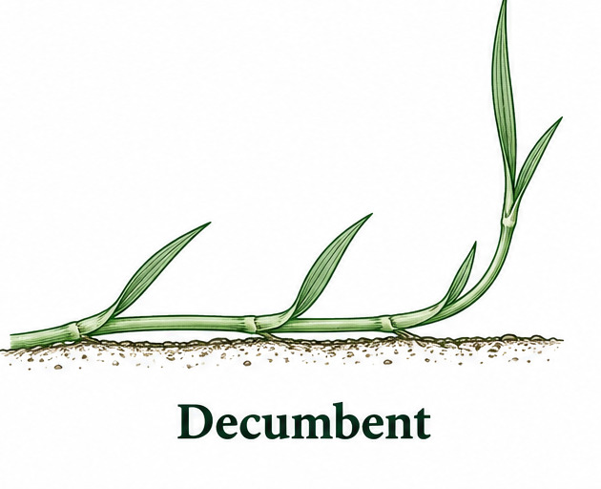
PLANT FORM
Posture, enclosure, and arrangement
Decumbent Lying along the ground at the base, with the tip rising.
Prostrate Lying along the ground.
Exserted Projecting beyond an enclosing structure.
Included Remaining within an enclosing structure.
Poa spikelet with two basal glumes and several overlapping florets.
Imbricate Overlapping like roof shingles.
Distichous / two-ranked Arranged in two longitudinal rows.
Tristichous / three-ranked Arranged in three longitudinal rows.
Decumbent: the tip rises from a reclining stem
Imbricate means overlapping. Two-ranked and three-ranked describe rows, not paired leaves.
11
Notes:
Decumbent: Lying along the ground at the base, with the tip rising. Prostrate: Lying along the ground. Exserted: Projecting beyond an enclosing structure. Included: Remaining within an enclosing structure. Imbricate: Overlapping like roof shingles. Distichous / two-ranked: Arranged in two longitudinal rows. Tristichous / three-ranked: Arranged in three longitudinal rows. Teaching notes
Imbricate means overlapping. Two-ranked and three-ranked describe rows, not paired leaves.
Illustration sources and attribution
D. M’Alpine, The Botanical Atlas (1882), Plate IV, Grass and Sedge; scan via Biodiversity Heritage Library / Wikimedia Commons. Public domain. Cropped from the plate. https://commons.wikimedia.org/wiki/File:The_botanical_atlas_(Plate_IV)_(7349108122).jpg
https://commons.wikimedia.org/wiki/File:The_botanical_atlas_(Plate_IV)_(7349108122).jpg
Historic illustration; upper caption is Fig. 2 Spikelet detached. Labels Outer Glumes correspond to modern glumes; the enclosing flowering bract of each floret is a lemma.
Generated educational schematic. Shape and proportions are illustrative.
Definitions from the preceding glossary, checked against the cited botanical references.
Core references
https://ncbg.unc.edu/research/unc-herbarium/floras/
https://www.iplant.cn/foc/pdf/Poaceae.pdf
https://herbarium.ncsu.edu/rare/carex.htm
https://herbarium.ncsu.edu/rushes/
https://vplants.org/portal/plants/glossary/index.php

Slide 12
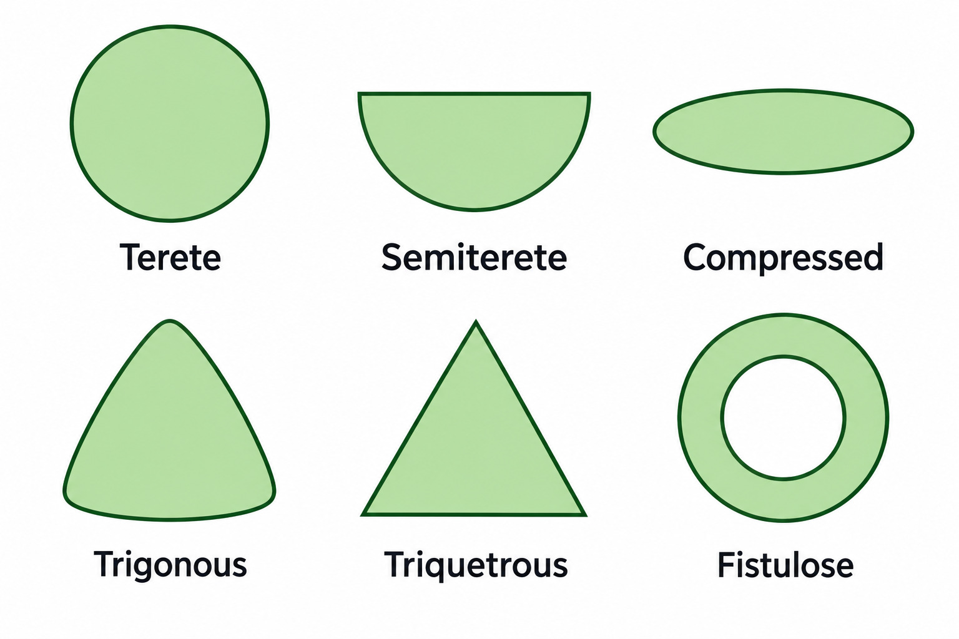
PLANT FORM
Stem and leaf cross-sections
Terete Approximately circular in cross-section.
Semiterete Approximately semicircular in cross-section.
Compressed Flattened.
Trigonous Three-angled in cross-section.
Triquetrous Sharply three-angled, with distinct edges.
Compare the outline of a transverse cut
Round, flattened and triangular stems occur among graminoids. These are shape terms.
12
Notes:
Terete: Approximately circular in cross-section. Semiterete: Approximately semicircular in cross-section. Compressed: Flattened. Trigonous: Three-angled in cross-section. Triquetrous: Sharply three-angled, with distinct edges. Teaching notes
Round, flattened and triangular stems occur among graminoids. These are shape terms.
Illustration sources and attribution
Generated educational schematic. Shape and proportions are illustrative.
Definitions from the preceding glossary, checked against the cited botanical references.
Core references
https://ncbg.unc.edu/research/unc-herbarium/floras/
https://www.iplant.cn/foc/pdf/Poaceae.pdf
https://herbarium.ncsu.edu/rare/carex.htm
https://herbarium.ncsu.edu/rushes/
https://vplants.org/portal/plants/glossary/index.php

Slide 13
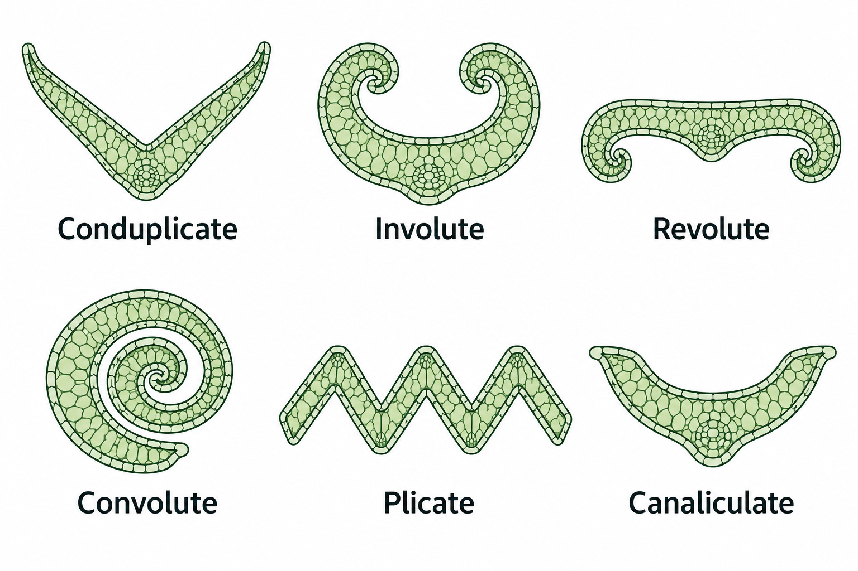
PLANT FORM
Folded and rolled leaves
Conduplicate Folded lengthwise, commonly forming a V in cross-section.
Involute With margins rolled inward toward the upper surface.
Revolute With margins rolled backward toward the lower surface.
Convolute Rolled lengthwise with one margin overlapping the other.
Plicate Having several lengthwise folds, like an accordion.
Schematic cross sections show folding and rolling
Convolute rolls the blade as a whole. Involute rolls its margins inward.
13
Notes:
Conduplicate: Folded lengthwise, commonly forming a V in cross-section. Involute: With margins rolled inward toward the upper surface. Revolute: With margins rolled backward toward the lower surface. Convolute: Rolled lengthwise with one margin overlapping the other. Plicate: Having several lengthwise folds, like an accordion. Teaching notes
Convolute rolls the blade as a whole. Involute rolls its margins inward.
Illustration sources and attribution
Generated educational schematic. Shape and proportions are illustrative.
Definitions from the preceding glossary, checked against the cited botanical references.
Core references
https://ncbg.unc.edu/research/unc-herbarium/floras/
https://www.iplant.cn/foc/pdf/Poaceae.pdf
https://herbarium.ncsu.edu/rare/carex.htm
https://herbarium.ncsu.edu/rushes/
https://vplants.org/portal/plants/glossary/index.php

Slide 14
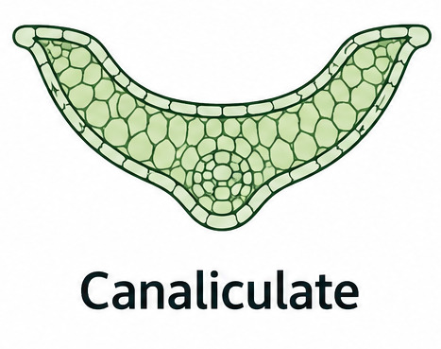
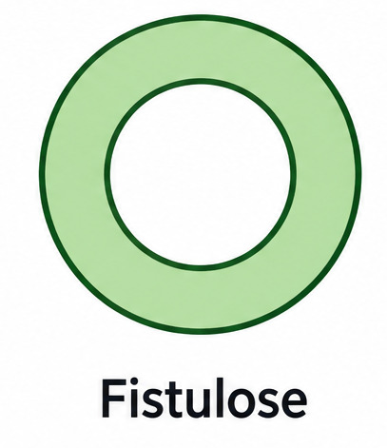
PLANT FORM
Channels, ridges, and interiors
Canaliculate Having a lengthwise channel or groove.
Sulcate Marked with grooves or furrows.
Keeled / carinate Having a prominent longitudinal ridge.
Fistulose Hollow and tubular.
A channel along the upper surface
Pith The tissue occupying the interior of a stem or similar structure.
A hollow tube in cross section
A keel is a ridge. A groove or channel is a depression. Pith occupies the interior.
14
Notes:
Canaliculate: Having a lengthwise channel or groove. Sulcate: Marked with grooves or furrows. Keeled / carinate: Having a prominent longitudinal ridge. Fistulose: Hollow and tubular. Pith: The tissue occupying the interior of a stem or similar structure. Teaching notes
A keel is a ridge. A groove or channel is a depression. Pith occupies the interior.
Illustration sources and attribution
Generated educational schematic. Shape and proportions are illustrative.
Definitions from the preceding glossary, checked against the cited botanical references.
Generated educational schematic. Shape and proportions are illustrative.
Definitions from the preceding glossary, checked against the cited botanical references.
Core references
https://ncbg.unc.edu/research/unc-herbarium/floras/
https://www.iplant.cn/foc/pdf/Poaceae.pdf
https://herbarium.ncsu.edu/rare/carex.htm
https://herbarium.ncsu.edu/rushes/
https://vplants.org/portal/plants/glossary/index.php

Slide 15
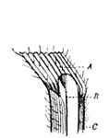
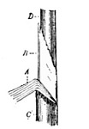
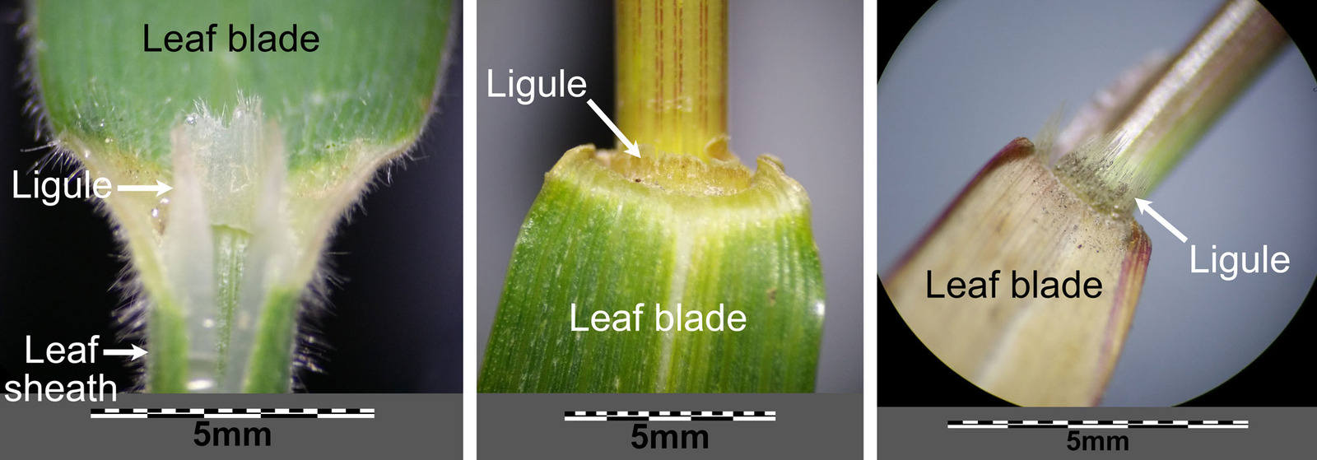
PLANT FORM
Sheaths, ligules, and young leaves
Open sheath A sheath whose margins are free, even if they overlap.
Closed sheath A sheath whose margins are fused for some or all of its length.
Bladeless sheath A leaf reduced chiefly to its sheath.
Ligulate Having a ligule.
Open sheath
Closed sheath
Eligulate Lacking a ligule.
Vernation How a young leaf is folded or rolled before expanding.
Membranous and hairy ligules
An overlapping seam can look closed. Check whether the margins actually fuse.
15
Notes:
Open sheath: A sheath whose margins are free, even if they overlap. Closed sheath: A sheath whose margins are fused for some or all of its length. Bladeless sheath: A leaf reduced chiefly to its sheath. Ligulate: Having a ligule. Eligulate: Lacking a ligule. Vernation: How a young leaf is folded or rolled before expanding. Teaching notes
An overlapping seam can look closed. Check whether the margins actually fuse.
Illustration sources and attribution
H. Marshall Ward, Grasses (1908). Public domain.
H. Marshall Ward, Grasses (1908). Public domain.
Stefan.Iefnaer. CC BY-SA 4.0. Adapted by PRI.
https://evolution.earthathome.org/grasses/morphology/
Core references
https://ncbg.unc.edu/research/unc-herbarium/floras/
https://www.iplant.cn/foc/pdf/Poaceae.pdf
https://herbarium.ncsu.edu/rare/carex.htm
https://herbarium.ncsu.edu/rushes/
https://vplants.org/portal/plants/glossary/index.php

Slide 16
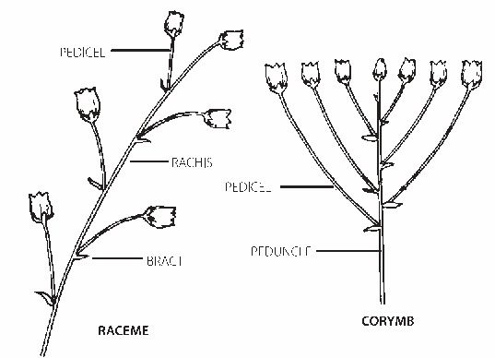
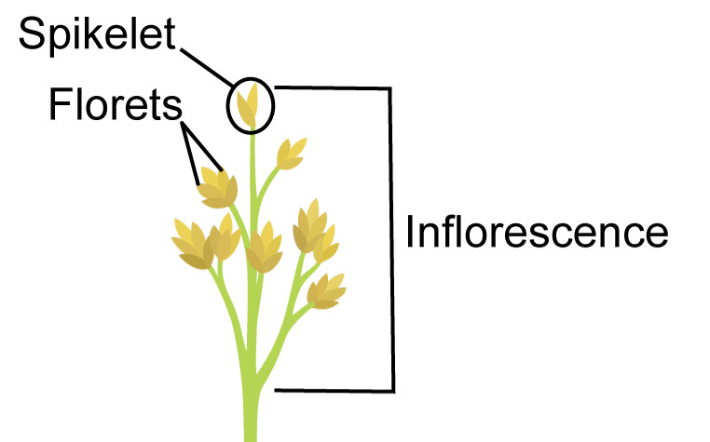
FLOWERING CLUSTERS
The axes of an inflorescence
Inflorescence The flower-bearing system, including its axes and branches.
Peduncle The stalk supporting an inflorescence or a distinct flowering cluster.
Pedicel The stalk of an individual flower; in grass keys, often of an individual spikelet.
Axes in ordinary flower clusters: pedicel, rachis, bract and peduncle
Rachis The main axis of an inflorescence or one of its branches.
Bract A modified leaf associated with a flower or inflorescence.
A grass inflorescence contains spikelets
16
Notes:
Inflorescence: The flower-bearing system, including its axes and branches. Peduncle: The stalk supporting an inflorescence or a distinct flowering cluster. Pedicel: The stalk of an individual flower; in grass keys, often of an individual spikelet. Rachis: The main axis of an inflorescence or one of its branches. Bract: A modified leaf associated with a flower or inflorescence. Teaching notes
General flower diagrams establish the axes; explain that pedicels in grass keys usually bear spikelets. The corymb is included only because it clearly labels a peduncle, not as an additional term to memorize.
Illustration sources and attribution
Illustrated Flora of North Central Texas, p. 1427; adapted from Mason (1957), © University of California Press
https://fwbg.org/wp-content/uploads/2025/04/FNCT_1353-1456-Appendices-Glossary.pdf
Kelvinsong, CC BY 3.0; adapted by Paleontological Research Institution / Earth@Home. Cropped from the provided image. https://evolution.earthathome.org/grasses/morphology/ — https://creativecommons.org/licenses/by/3.0/
https://evolution.earthathome.org/grasses/morphology/
Core references
https://ncbg.unc.edu/research/unc-herbarium/floras/
https://www.iplant.cn/foc/pdf/Poaceae.pdf
https://herbarium.ncsu.edu/rare/carex.htm
https://herbarium.ncsu.edu/rushes/
https://vplants.org/portal/plants/glossary/index.php

Slide 17
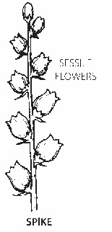
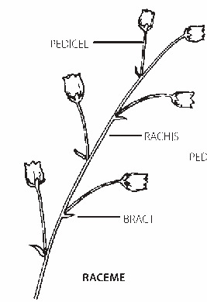
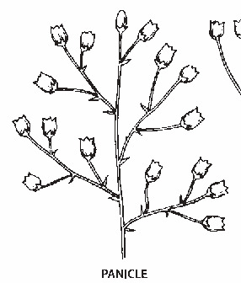
FLOWERING CLUSTERS
Spike, raceme, or panicle?
Panicle A branched inflorescence; in grasses its branches bear spikelets.
Open panicle A panicle with spreading, readily distinguishable branches.
Contracted panicle A narrow panicle with branches held close to its axis.
Spiciform Spikelike in appearance.
Spike An unbranched axis bearing sessile flowers or spikelets.
Raceme An unbranched axis bearing stalked flowers or spikelets.
Spike: sessile units on one unbranched axis
Raceme: stalked units on one unbranched axis
Panicle: branches bear the flowering units
17
Notes:
Panicle: A branched inflorescence; in grasses its branches bear spikelets. Open panicle: A panicle with spreading, readily distinguishable branches. Contracted panicle: A narrow panicle with branches held close to its axis. Spiciform: Spikelike in appearance. Spike: An unbranched axis bearing sessile flowers or spikelets. Raceme: An unbranched axis bearing stalked flowers or spikelets. Teaching notes
These are generalized flower diagrams; the equivalent units in grasses are spikelets. Do not use thyrse as a contracted grass panicle.
Illustration sources and attribution
Illustrated Flora of North Central Texas, p. 1427; adapted from Mason (1957), © University of California Press
https://fwbg.org/wp-content/uploads/2025/04/FNCT_1353-1456-Appendices-Glossary.pdf
Illustrated Flora of North Central Texas, p. 1427; adapted from Mason (1957), © University of California Press
https://fwbg.org/wp-content/uploads/2025/04/FNCT_1353-1456-Appendices-Glossary.pdf
Illustrated Flora of North Central Texas, p. 1427; adapted from Mason (1957), © University of California Press
https://fwbg.org/wp-content/uploads/2025/04/FNCT_1353-1456-Appendices-Glossary.pdf
Core references
https://ncbg.unc.edu/research/unc-herbarium/floras/
https://www.iplant.cn/foc/pdf/Poaceae.pdf
https://herbarium.ncsu.edu/rare/carex.htm
https://herbarium.ncsu.edu/rushes/
https://vplants.org/portal/plants/glossary/index.php

Slide 18
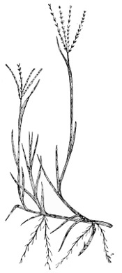
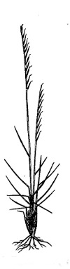
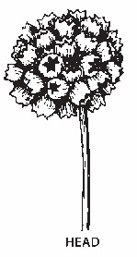
FLOWERING CLUSTERS
Fingers, bundles, and heads
Digitate Several branches arising together like fingers from a hand.
Subdigitate Nearly digitate, but branch origins are slightly separated.
Secund Having flowers or spikelets directed toward one side.
Fascicle A bundle or close cluster.
Glomerule A small, tightly packed cluster.
Head / capitulum A compact cluster of sessile or nearly sessile flowers or spikelets.
Capitate Head-shaped or arranged in a head.
Digitate: Cynodon branches arise like fingers
Secund: Nardus spikelets face one side
Head / capitulum: a dense terminal cluster
18
Notes:
Digitate: Several branches arising together like fingers from a hand. Subdigitate: Nearly digitate, but branch origins are slightly separated. Secund: Having flowers or spikelets directed toward one side. Fascicle: A bundle or close cluster. Glomerule: A small, tightly packed cluster. Head / capitulum: A compact cluster of sessile or nearly sessile flowers or spikelets. Capitate: Head-shaped or arranged in a head. The head is a generalized flowering-plant example.
Illustration sources and attribution
Parnell, in Ward, Grasses (1908), Fig. 5; public domain
https://www.gutenberg.org/files/47898/47898-h/47898-h.htm
Parnell, in Ward, Grasses (1908), Fig. 2; public domain
https://www.gutenberg.org/files/47898/47898-h/47898-h.htm
Illustrated Flora of North Central Texas, p. 1427; adapted from Mason (1957), © University of California Press
https://fwbg.org/wp-content/uploads/2025/04/FNCT_1353-1456-Appendices-Glossary.pdf
Core references
https://ncbg.unc.edu/research/unc-herbarium/floras/
https://www.iplant.cn/foc/pdf/Poaceae.pdf
https://herbarium.ncsu.edu/rare/carex.htm
https://herbarium.ncsu.edu/rushes/
https://vplants.org/portal/plants/glossary/index.php

Slide 19
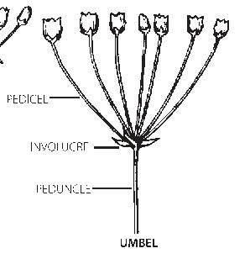
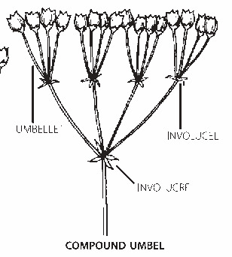
FLOWERING CLUSTERS
Rays, bracts, and branching
Umbel An arrangement in which stalks arise from approximately one point.
Ray A principal branch of an umbel or umbel-like inflorescence.
Involucre A group of bracts surrounding or subtending a flowering cluster.
Involucral bract One of the bracts forming an involucre.
Simple umbel: stalks from one point; involucral bracts below
Congested Densely crowded.
Interrupted Having clusters separated by conspicuous gaps.
Simple / compound Unbranched or undivided / divided into additional branches or units.
Compound umbel: main rays carry smaller umbels
19
Notes:
Umbel: An arrangement in which stalks arise from approximately one point. Ray: A principal branch of an umbel or umbel-like inflorescence. Involucre: A group of bracts surrounding or subtending a flowering cluster. Involucral bract: One of the bracts forming an involucre. Congested: Densely crowded. Interrupted: Having clusters separated by conspicuous gaps. Simple / compound: Unbranched or undivided / divided into additional branches or units. Teaching notes
Use the compound illustration to point out a ray. These are ordinary flower umbels, not a claim that all sedge umbel-like clusters are true umbels.
Illustration sources and attribution
Illustrated Flora of North Central Texas, p. 1427; adapted from Mason (1957), © University of California Press
https://fwbg.org/wp-content/uploads/2025/04/FNCT_1353-1456-Appendices-Glossary.pdf
Illustrated Flora of North Central Texas, p. 1427; adapted from Mason (1957), © University of California Press
https://fwbg.org/wp-content/uploads/2025/04/FNCT_1353-1456-Appendices-Glossary.pdf
Core references
https://ncbg.unc.edu/research/unc-herbarium/floras/
https://www.iplant.cn/foc/pdf/Poaceae.pdf
https://herbarium.ncsu.edu/rare/carex.htm
https://herbarium.ncsu.edu/rushes/
https://vplants.org/portal/plants/glossary/index.php

Slide 20
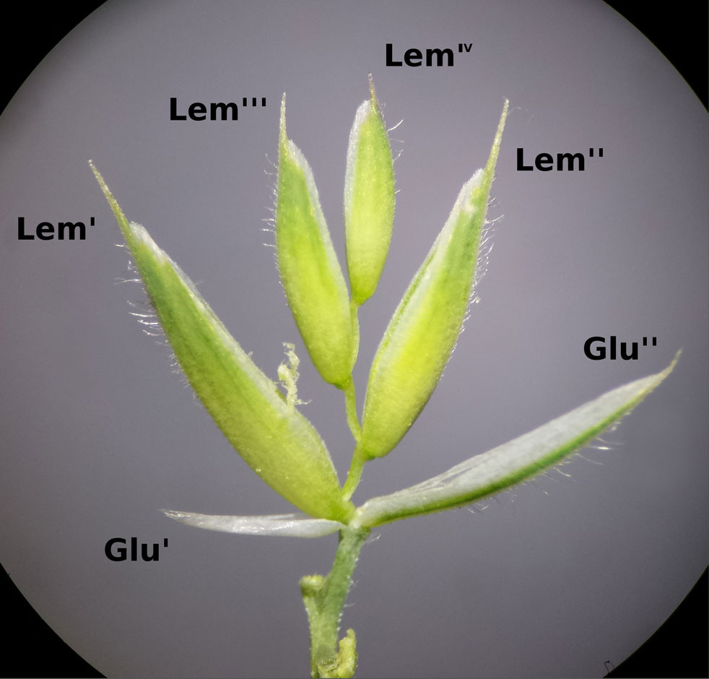
GRASSES AND FLOWERS
A spikelet contains florets
Spikelet The basic grass flowering unit, usually containing basal glumes and one or more florets.
Floret One grass flower with its associated lemma and palea; some parts may be reduced.
Glumes Usually two bracts at the base of a spikelet, below the florets.
Lower / first glume The glume attached lower on the spikelet axis.
Upper / second glume The next glume above it.
Two glumes below four florets; lemmas labeled I–IV
20
Notes:
Spikelet: The basic grass flowering unit, usually containing basal glumes and one or more florets. Floret: One grass flower with its associated lemma and palea; some parts may be reduced. Glumes: Usually two bracts at the base of a spikelet, below the florets. Lower / first glume: The glume attached lower on the spikelet axis. Upper / second glume: The next glume above it. Teaching notes
Define Glu I and Glu II as lower and upper glumes; Lem I–IV identify lemmas of successive florets. Both cropped photographs omit their original shared scale bars. No size should be inferred.
Illustration sources and attribution
Stefan.Iefnaer, CC BY-SA 4.0; adapted by Paleontological Research Institution / Earth@Home. Crop adaptation remains CC BY-SA 4.0. https://evolution.earthathome.org/grasses/morphology/ — https://creativecommons.org/licenses/by-sa/4.0/
https://evolution.earthathome.org/grasses/morphology/
Core references
https://ncbg.unc.edu/research/unc-herbarium/floras/
https://www.iplant.cn/foc/pdf/Poaceae.pdf
https://herbarium.ncsu.edu/rare/carex.htm
https://herbarium.ncsu.edu/rushes/
https://vplants.org/portal/plants/glossary/index.php

Slide 21
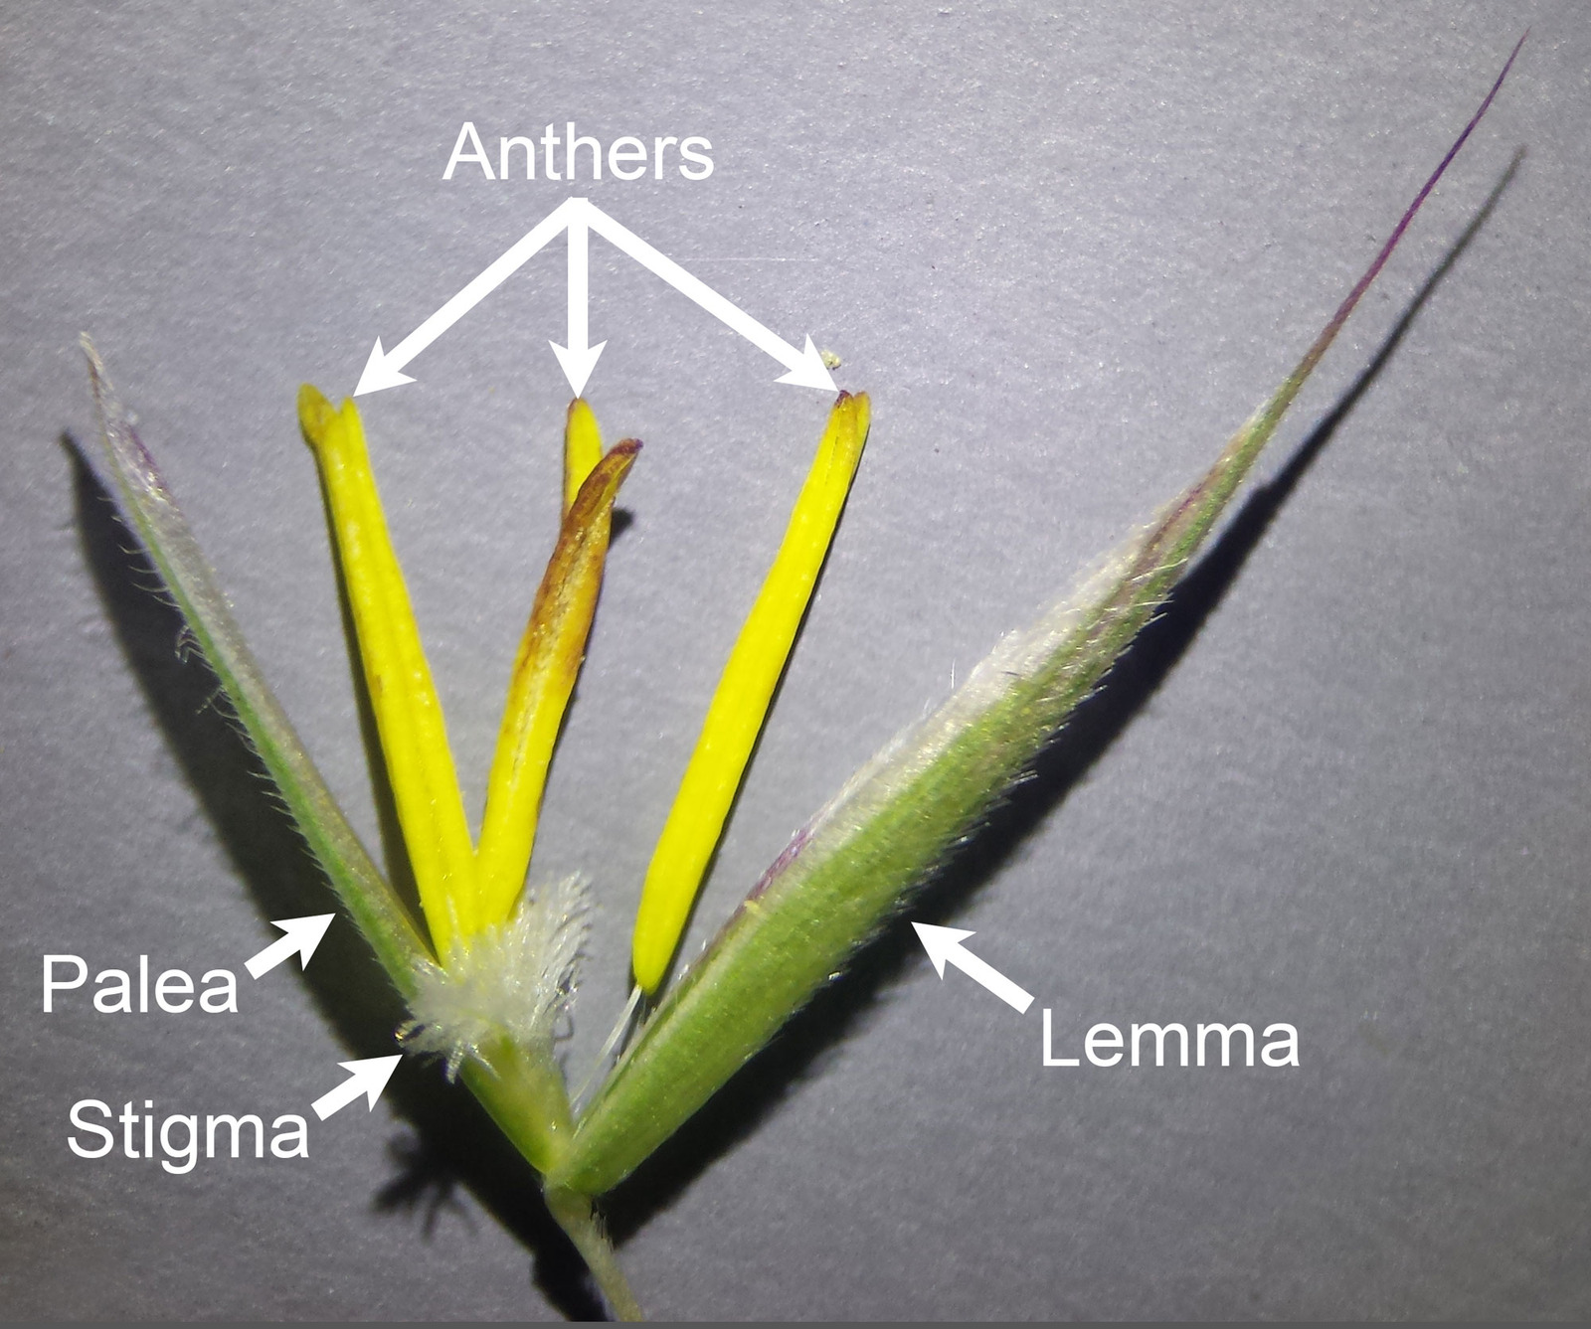
GRASSES AND FLOWERS
Inside a grass floret
Lemma The outer bract associated with an individual grass flower.
Palea The inner bract facing the spikelet axis, often two-keeled.
Inside one floret: lemma and palea enclose the flower
21
Notes:
Lemma: The outer bract associated with an individual grass flower. Palea: The inner bract facing the spikelet axis, often two-keeled. Teaching notes
Define Glu I and Glu II as lower and upper glumes; Lem I–IV identify lemmas of successive florets. Both cropped photographs omit their original shared scale bars. No size should be inferred.
Illustration sources and attribution
Stefan.Iefnaer, CC BY-SA 4.0; adapted by Paleontological Research Institution / Earth@Home. Crop adaptation remains CC BY-SA 4.0. https://evolution.earthathome.org/grasses/morphology/ — https://creativecommons.org/licenses/by-sa/4.0/
https://evolution.earthathome.org/grasses/morphology/
Core references
https://ncbg.unc.edu/research/unc-herbarium/floras/
https://www.iplant.cn/foc/pdf/Poaceae.pdf
https://herbarium.ncsu.edu/rare/carex.htm
https://herbarium.ncsu.edu/rushes/
https://vplants.org/portal/plants/glossary/index.php

Slide 22
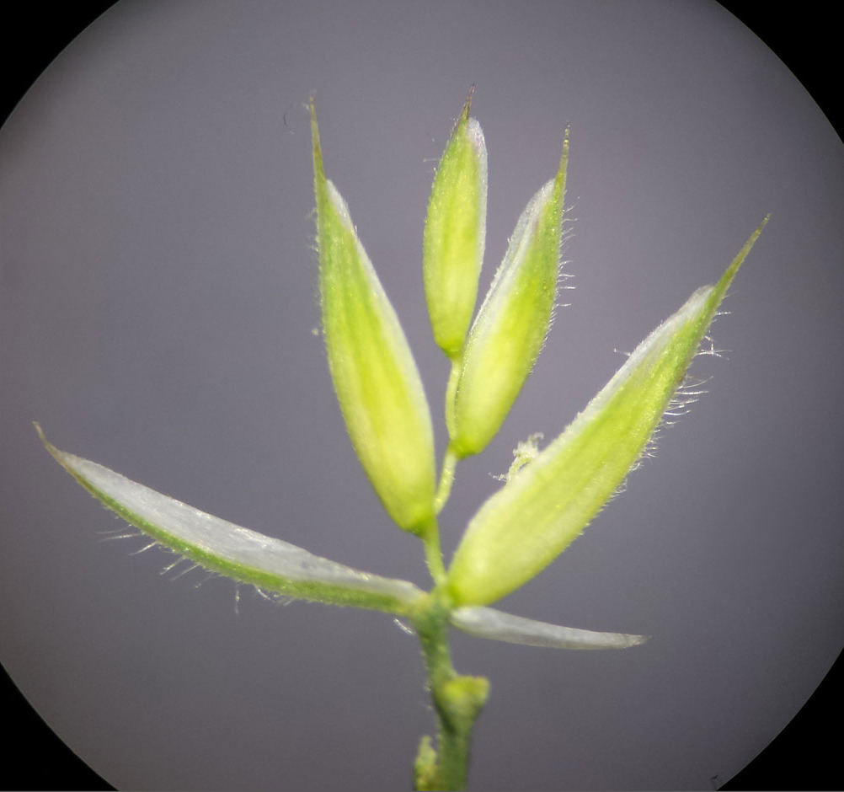
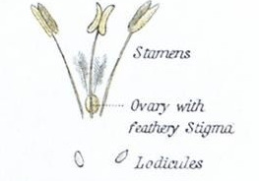
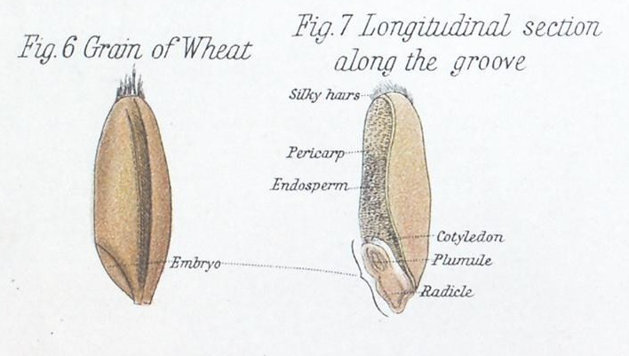
GRASSES AND FLOWERS
Inside a grass spikelet and grain
Rachilla The small axis inside a spikelet.
Rachilla extension A continuation of that axis beyond the uppermost developed floret.
Lower floret A floret attached below another on the rachilla.
Upper floret A floret attached above another on the rachilla.
Follow the rachilla from lower to upper florets
Lodicules: the tiny pair beside the flower base
Lodicules Tiny floral structures that commonly swell to help open a grass floret.
Caryopsis / grain A one-seeded fruit whose wall is fused to the seed coat.
Hilum The seed attachment scar; its shape can help identify some grasses.
Caryopsis: whole wheat grain and longitudinal section
22
Notes:
Rachilla: The small axis inside a spikelet. Rachilla extension: A continuation of that axis beyond the uppermost developed floret. Lower floret: A floret attached below another on the rachilla. Upper floret: A floret attached above another on the rachilla. Lodicules: Tiny floral structures that commonly swell to help open a grass floret. Caryopsis / grain: A one-seeded fruit whose wall is fused to the seed coat. Hilum: The seed attachment scar; its shape can help identify some grasses. Do not call the embryo or groove the hilum. Historical labels Flowering Glume=lemma and Pale=palea; translate on slide.
Illustration sources and attribution
Stefan.Iefnaer, CC BY-SA 4.0; adapted by Paleontological Research Institution / Earth@Home. Crop adaptation remains CC BY-SA 4.0. https://evolution.earthathome.org/grasses/morphology/ — https://creativecommons.org/licenses/by-sa/4.0/
https://evolution.earthathome.org/grasses/morphology/
D. M’Alpine, The Botanical Atlas (1882), Plate IV, Grass and Sedge; scan via Biodiversity Heritage Library / Wikimedia Commons. Public domain. Cropped from the plate. https://commons.wikimedia.org/wiki/File:The_botanical_atlas_(Plate_IV)_(7349108122).jpg
https://commons.wikimedia.org/wiki/File:The_botanical_atlas_(Plate_IV)_(7349108122).jpg
D. M’Alpine, The Botanical Atlas (1882), Plate IV, Grass and Sedge; scan via Biodiversity Heritage Library / Wikimedia Commons. Public domain. Cropped from the plate. https://commons.wikimedia.org/wiki/File:The_botanical_atlas_(Plate_IV)_(7349108122).jpg
https://commons.wikimedia.org/wiki/File:The_botanical_atlas_(Plate_IV)_(7349108122).jpg
Core references
https://ncbg.unc.edu/research/unc-herbarium/floras/
https://www.iplant.cn/foc/pdf/Poaceae.pdf
https://herbarium.ncsu.edu/rare/carex.htm
https://herbarium.ncsu.edu/rushes/
https://vplants.org/portal/plants/glossary/index.php

Slide 23
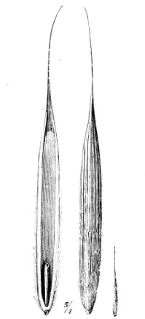
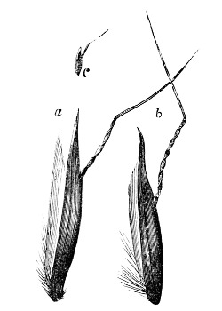
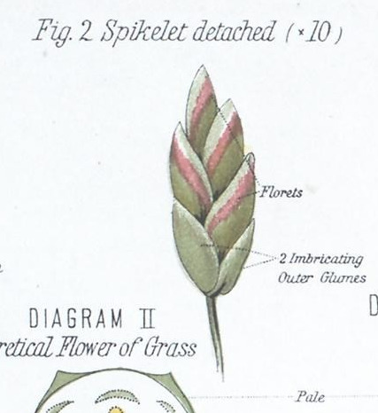
GRASSES AND FLOWERS
Recognizing awns
Awn A slender bristlelike projection, commonly from a lemma or glume.
Aristate Bearing an awn.
Aristulate Bearing a small awn.
Muticous Lacking an awn or pointed projection.
Terminal awn An awn arising from the tip.
Dorsal awn An awn arising from the back of a lemma.
Terminal awn arises at the lemma tip
Dorsal awn arises from the lemma back
Poa: awnless, or muticous, florets
23
Notes:
Awn: A slender bristlelike projection, commonly from a lemma or glume. Aristate: Bearing an awn. Aristulate: Bearing a small awn. Muticous: Lacking an awn or pointed projection. Terminal awn: An awn arising from the tip. Dorsal awn: An awn arising from the back of a lemma. Dorsal awn also happens to be twisted and geniculate. Aristate means awned rather than a distinct awn shape.
Illustration sources and attribution
Stebler, in Ward, Grasses (1908), Fig. 71; public domain
https://www.gutenberg.org/files/47898/47898-h/47898-h.htm
Nobbe, in Ward, Grasses (1908), Fig. 69; public domain
https://www.gutenberg.org/files/47898/47898-h/47898-h.htm
D. M’Alpine, The Botanical Atlas (1882), Plate IV, Grass and Sedge; scan via Biodiversity Heritage Library / Wikimedia Commons. Public domain. Cropped from the plate. https://commons.wikimedia.org/wiki/File:The_botanical_atlas_(Plate_IV)_(7349108122).jpg
https://commons.wikimedia.org/wiki/File:The_botanical_atlas_(Plate_IV)_(7349108122).jpg
Core references
https://ncbg.unc.edu/research/unc-herbarium/floras/
https://www.iplant.cn/foc/pdf/Poaceae.pdf
https://herbarium.ncsu.edu/rare/carex.htm
https://herbarium.ncsu.edu/rushes/
https://vplants.org/portal/plants/glossary/index.php

Slide 24
GRASSES AND FLOWERS
Bent awns and firm bases
Geniculate Bent like a knee.
Awn column The basal, often twisted portion of an awn.
Callus A firm basal portion of a floret, spikelet, or dispersing segment.
A dorsal, geniculate awn
24
Notes:
Geniculate: Bent like a knee. Awn column: The basal, often twisted portion of an awn. Callus: A firm basal portion of a floret, spikelet, or dispersing segment. Teaching notes
Generated disarticulation comparison accepted after rejecting two inconsistent before/after variants. Final schematic shows two green florets per column, two ochre glumes, and correct break positions. The awn illustration shows a knee and twisted column; a firm basal callus is not separately labeled.
Illustration sources and attribution
H. Marshall Ward, Grasses (1908). Public domain.
Core references
https://ncbg.unc.edu/research/unc-herbarium/floras/
https://www.iplant.cn/foc/pdf/Poaceae.pdf
https://herbarium.ncsu.edu/rare/carex.htm
https://herbarium.ncsu.edu/rushes/
https://vplants.org/portal/plants/glossary/index.php

Slide 25
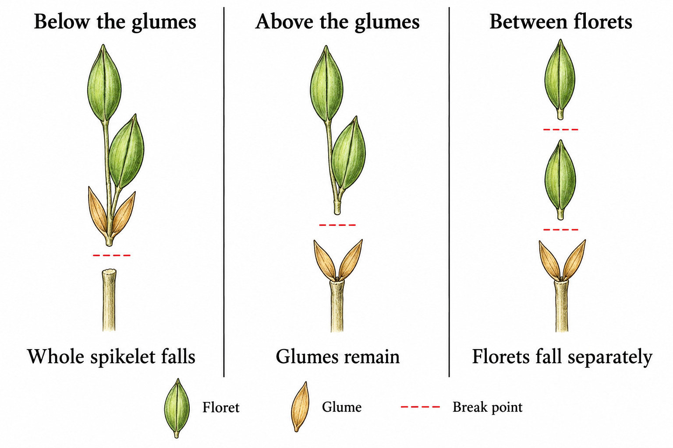
GRASSES AND FLOWERS
Where a spikelet breaks apart
Disarticulation Natural separation at a defined joint or breaking point.
Disarticulating below the glumes The glumes fall with the rest of the spikelet.
Disarticulating above the glumes The glumes remain while structures above them separate.
Disarticulating between florets The rachilla breaks into separate floret-bearing pieces.
The separation point determines which parts fall together
25
Notes:
Disarticulation: Natural separation at a defined joint or breaking point. Disarticulating below the glumes: The glumes fall with the rest of the spikelet. Disarticulating above the glumes: The glumes remain while structures above them separate. Disarticulating between florets: The rachilla breaks into separate floret-bearing pieces. Teaching notes
Generated disarticulation comparison accepted after rejecting two inconsistent before/after variants. Final schematic shows two green florets per column, two ochre glumes, and correct break positions. The awn illustration shows a knee and twisted column; a firm basal callus is not separately labeled.
Illustration sources and attribution
Generated educational schematic. Shape and proportions are illustrative.
Definitions from the preceding glossary, checked against the cited botanical references.
Core references
https://ncbg.unc.edu/research/unc-herbarium/floras/
https://www.iplant.cn/foc/pdf/Poaceae.pdf
https://herbarium.ncsu.edu/rare/carex.htm
https://herbarium.ncsu.edu/rushes/
https://vplants.org/portal/plants/glossary/index.php

Slide 26
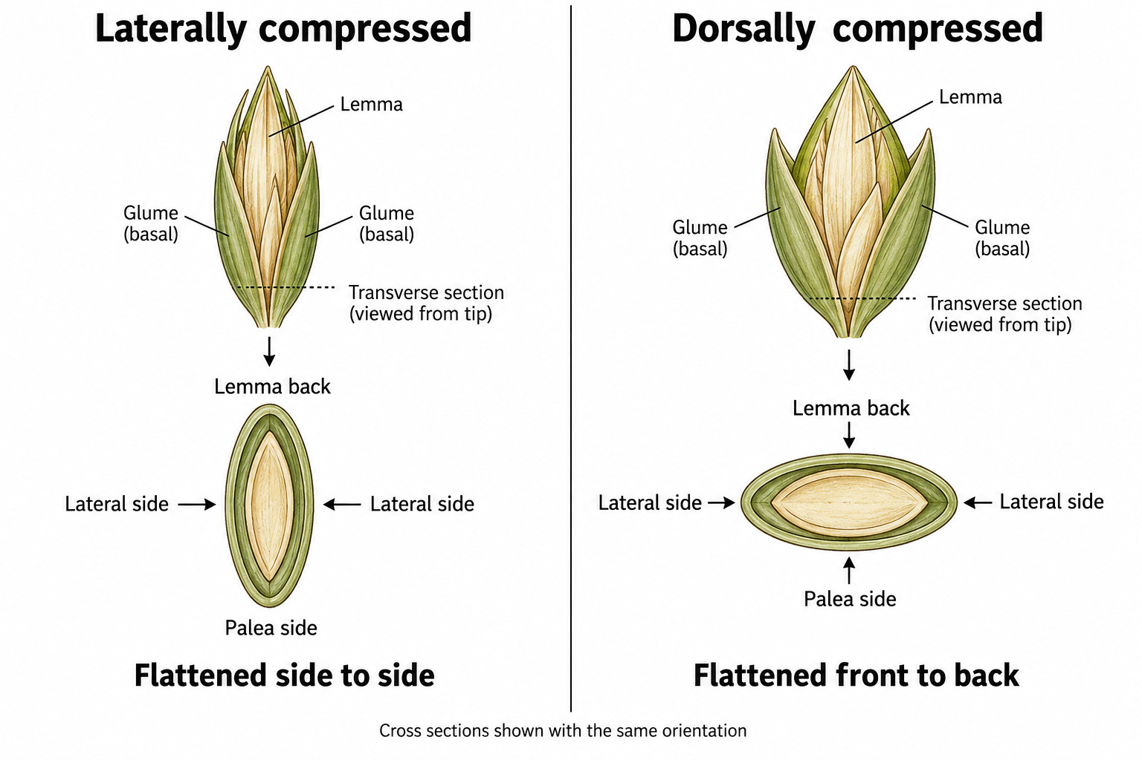
GRASSES AND FLOWERS
Compression and firmness
Laterally compressed Flattened from side to side.
Dorsally compressed Flattened from front to back.
Indurate Hardened.
Coriaceous Leathery.
Chartaceous Having the texture of paper.
Compare flattening relative to the lemma and palea
26
Notes:
Laterally compressed: Flattened from side to side. Dorsally compressed: Flattened from front to back. Indurate: Hardened. Coriaceous: Leathery. Chartaceous: Having the texture of paper. Teaching notes
Generated cross-section comparison has correct axes: lateral compression narrows side-to-side; dorsal compression narrows lemma-back to palea-side distance. Cross sections are schematic, not histology.
Illustration sources and attribution
Generated educational schematic. Shape and proportions are illustrative.
Definitions from the preceding glossary, checked against the cited botanical references.
Core references
https://ncbg.unc.edu/research/unc-herbarium/floras/
https://www.iplant.cn/foc/pdf/Poaceae.pdf
https://herbarium.ncsu.edu/rare/carex.htm
https://herbarium.ncsu.edu/rushes/
https://vplants.org/portal/plants/glossary/index.php

Slide 27
GRASSES AND FLOWERS
Bluestems and paired spikelets
Rame A spikelet-bearing inflorescence branch, especially in the bluestem tribe.
Sessile spikelet A spikelet attached directly, without its own stalk.
Pedicellate spikelet A spikelet borne on a pedicel.
Heterogamous pair Paired spikelets that differ in reproductive function.
Homogamous pair Paired spikelets with the same reproductive condition.
Spathe A modified leaf associated with or enclosing an inflorescence.
Spatheole A small sheathlike bract subtending or enclosing an ultimate flowering unit.
Sorghum: sessile and pedicellate spikelets on a branch
27
Notes:
Rame: A spikelet-bearing inflorescence branch, especially in the bluestem tribe. Sessile spikelet: A spikelet attached directly, without its own stalk. Pedicellate spikelet: A spikelet borne on a pedicel. Heterogamous pair: Paired spikelets that differ in reproductive function. Homogamous pair: Paired spikelets with the same reproductive condition. Spathe: A modified leaf associated with or enclosing an inflorescence. Spatheole: A small sheathlike bract subtending or enclosing an ultimate flowering unit. Teaching notes
Sorghum is an Andropogoneae example, not a bluestem species. Sessile spikelets here are bisexual and pedicellate ones can be male or sterile, supporting a heterogamous arrangement. Keep full image to preserve labels and scale.
Illustration sources and attribution
Stefan.Iefnaer / Earth@Home, CC BY-SA 4.0; cropped
https://evolution.earthathome.org/grasses/morphology/
Core references
https://ncbg.unc.edu/research/unc-herbarium/floras/
https://www.iplant.cn/foc/pdf/Poaceae.pdf
https://herbarium.ncsu.edu/rare/carex.htm
https://herbarium.ncsu.edu/rushes/
https://vplants.org/portal/plants/glossary/index.php

Slide 28
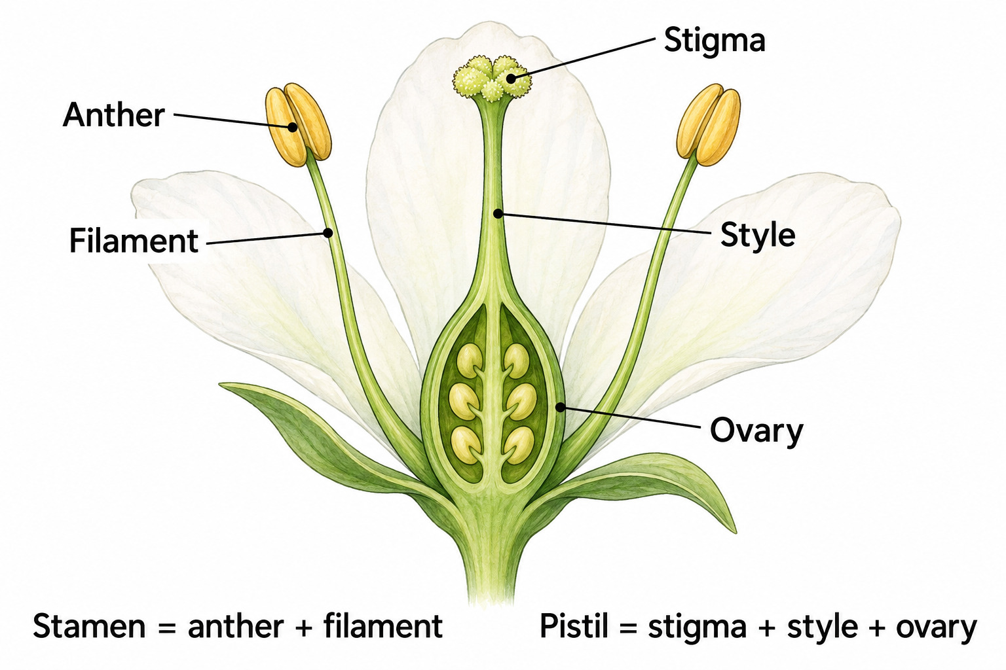
GRASSES AND FLOWERS
The organs of a flower
Stamen A pollen-producing floral organ consisting of anther and filament.
Anther The pollen-bearing portion of a stamen.
Filament The stalk supporting an anther.
Pistil The female floral structure, including ovary, style, and stigma.
Ovary The part containing ovules and developing into the fruit.
Style The portion connecting ovary and stigma.
Stigma The pollen-receptive surface.
Generalized flower schematic; the same organs occur in graminoids
28
Notes:
Stamen: A pollen-producing floral organ consisting of anther and filament. Anther: The pollen-bearing portion of a stamen. Filament: The stalk supporting an anther. Pistil: The female floral structure, including ovary, style, and stigma. Ovary: The part containing ovules and developing into the fruit. Style: The portion connecting ovary and stigma. Stigma: The pollen-receptive surface. Teaching notes
Generalized flower schematic is not a grass flower: its conspicuous petals/sepals provide context only. The grass photograph lacks visible lodicules and has no scale after cropping.
Illustration sources and attribution
Generated educational schematic. Shape and proportions are illustrative.
Definitions from the preceding glossary, checked against the cited botanical references.
Core references
https://ncbg.unc.edu/research/unc-herbarium/floras/
https://www.iplant.cn/foc/pdf/Poaceae.pdf
https://herbarium.ncsu.edu/rare/carex.htm
https://herbarium.ncsu.edu/rushes/
https://vplants.org/portal/plants/glossary/index.php

Slide 29
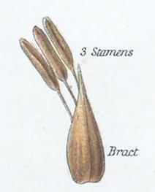
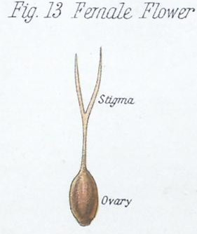
GRASSES AND FLOWERS
Flower sex versus plant sex
Staminate Functionally male.
Pistillate Functionally female.
Bisexual / perfect Having functional stamens and pistil in the same flower.
Unisexual Functionally either male or female.
Staminate: three stamens in one Carex flower
Pistillate: ovary and stigma branches in one Carex flower
Monoecious Separate male and female flowers occur on the same plant.
Dioecious Male and female flowers occur on different plants.
Bisexual: stamens and pistil within one grass flower
29
Notes:
Staminate: Functionally male. Pistillate: Functionally female. Bisexual / perfect: Having functional stamens and pistil in the same flower. Unisexual: Functionally either male or female. Monoecious: Separate male and female flowers occur on the same plant. Dioecious: Male and female flowers occur on different plants. Explain explicitly that monoecious = separate male/female flowers on ONE plant; dioecious = on DIFFERENT plants. Do not use the Carex sex-arrangement illustration to imply dioecy.
Illustration sources and attribution
D. M’Alpine, The Botanical Atlas (1882), Plate IV, Grass and Sedge; scan via Biodiversity Heritage Library / Wikimedia Commons. Public domain. Cropped from the plate. https://commons.wikimedia.org/wiki/File:The_botanical_atlas_(Plate_IV)_(7349108122).jpg
https://commons.wikimedia.org/wiki/File:The_botanical_atlas_(Plate_IV)_(7349108122).jpg
D. M’Alpine, The Botanical Atlas (1882), Plate IV, Grass and Sedge; scan via Biodiversity Heritage Library / Wikimedia Commons. Public domain. Cropped from the plate. https://commons.wikimedia.org/wiki/File:The_botanical_atlas_(Plate_IV)_(7349108122).jpg
https://commons.wikimedia.org/wiki/File:The_botanical_atlas_(Plate_IV)_(7349108122).jpg
Stefan.Iefnaer, CC BY-SA 4.0; adapted by Paleontological Research Institution / Earth@Home. Crop adaptation remains CC BY-SA 4.0. https://evolution.earthathome.org/grasses/morphology/ — https://creativecommons.org/licenses/by-sa/4.0/
https://evolution.earthathome.org/grasses/morphology/
Core references
https://ncbg.unc.edu/research/unc-herbarium/floras/
https://www.iplant.cn/foc/pdf/Poaceae.pdf
https://herbarium.ncsu.edu/rare/carex.htm
https://herbarium.ncsu.edu/rushes/
https://vplants.org/portal/plants/glossary/index.php

Slide 30
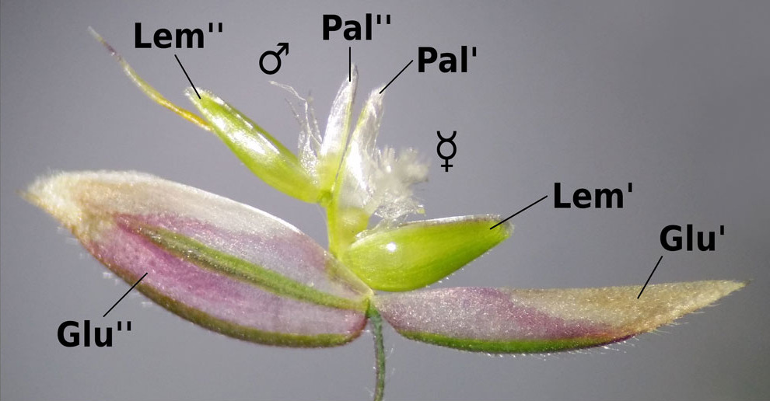
GRASSES AND FLOWERS
Flowering, fertility, and closed flowers
Fertile floret In grass keys, generally a floret capable of producing a grain.
Barren / neuter Lacking functional reproductive organs.
Anthesis The flowering period when a flower is functioning.
Chasmogamous Having flowers that open.
Cleistogamous Having flowers that remain closed and self-pollinate.
Sterile In some grass treatments, a floret that does not produce grain; it may still produce pollen. Read the treatment's usage.
Holcus: lower bisexual floret; upper pollen-producing male floret
30
Notes:
Fertile floret: In grass keys, generally a floret capable of producing a grain. Barren / neuter: Lacking functional reproductive organs. Anthesis: The flowering period when a flower is functioning. Chasmogamous: Having flowers that open. Cleistogamous: Having flowers that remain closed and self-pollinate. Sterile: In some grass treatments, a floret that does not produce grain; it may still produce pollen. Read the treatment's usage. Teaching notes
A male floret can be called sterile in a grain-focused key while still producing pollen; it is not barren/neuter. This image was dissected open, so it cannot demonstrate chasmogamy. Shared scale bar omitted.
Illustration sources and attribution
Stefan.Iefnaer / Earth@Home, CC BY-SA 4.0; cropped
https://evolution.earthathome.org/grasses/morphology/
Core references
https://ncbg.unc.edu/research/unc-herbarium/floras/
https://www.iplant.cn/foc/pdf/Poaceae.pdf
https://herbarium.ncsu.edu/rare/carex.htm
https://herbarium.ncsu.edu/rushes/
https://vplants.org/portal/plants/glossary/index.php

Slide 31
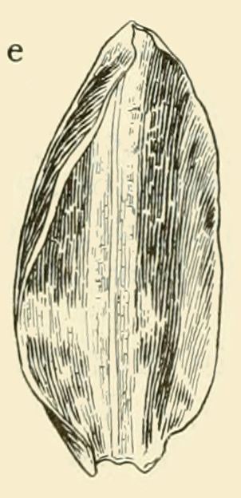
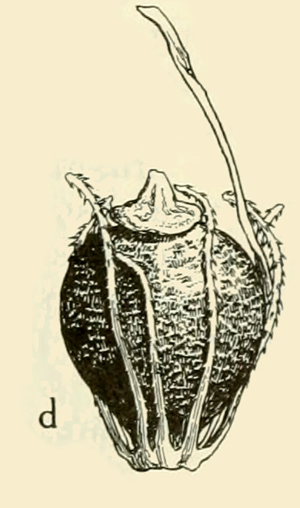
SEDGES
Sedge flowers, scales, and fruits
Achene A dry, one-seeded fruit that remains closed at maturity; its wall is separate from the seed coat.
Nutlet A name sometimes used for a small, hard sedge fruit.
Floral scale A small bract subtending an individual sedge flower.
Pistillate scale The scale associated with a female flower.
Sedge glume Another name for a floral scale; its use differs from glume in grasses.
Floral scale
Achene or nutlet
31
Notes:
Achene: A dry, one-seeded fruit that remains closed at maturity; its wall is separate from the seed coat. Nutlet: A name sometimes used for a small, hard sedge fruit. Floral scale: A small bract subtending an individual sedge flower. Pistillate scale: The scale associated with a female flower. Sedge glume: Another name for a floral scale; its use differs from glume in grasses. Teaching notes
Separate source details show a sedge floral scale and fruit. The Carex detail demonstrates a pistillate scale. Fruit wall versus seed coat is explained in text, not cut away here. Minor adjacent illustration fragments occur at the edges of the Carex scale crop.
Illustration sources and attribution
Correll & Correll (1972), via Wikimedia Commons. Public-domain source per Commons.
https://commons.wikimedia.org/wiki/File:Eleocharis_flavescens_AWP-SW.png
Correll & Correll (1972), via Wikimedia Commons. Public-domain source per Commons.
https://commons.wikimedia.org/wiki/File:Eleocharis_flavescens_AWP-SW.png
Core references
https://ncbg.unc.edu/research/unc-herbarium/floras/
https://www.iplant.cn/foc/pdf/Poaceae.pdf
https://herbarium.ncsu.edu/rare/carex.htm
https://herbarium.ncsu.edu/rushes/
https://vplants.org/portal/plants/glossary/index.php

Slide 32
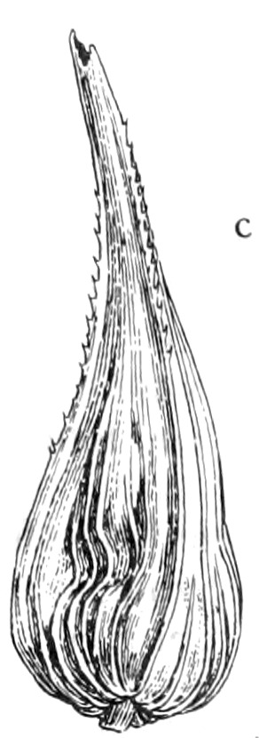
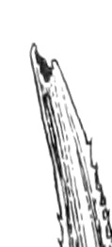
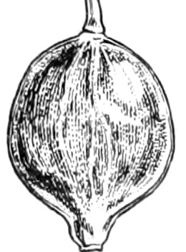
SEDGES
Carex: the envelope around the fruit
Perigynium The envelope surrounding the female flower and achene in Carex. Plural: perigynia.
Utricle Often another name for a closed perigynium in sedge descriptions.
Perigynium body The main expanded portion below its beak.
Beak / rostrum A narrowed, projecting tip.
Rostrate Beaked.
Bidentate Having two teeth, often at a perigynium's beak opening.
Perigynium: body and beak
Two teeth at the beak tip
Achene removed from the perigynium
32
Notes:
Perigynium: The envelope surrounding the female flower and achene in Carex. Plural: perigynia. Utricle: Often another name for a closed perigynium in sedge descriptions. Perigynium body: The main expanded portion below its beak. Beak / rostrum: A narrowed, projecting tip. Rostrate: Beaked. Bidentate: Having two teeth, often at a perigynium's beak opening. Teaching notes
Carex stipata. Intact perigynium and extracted achene are distinct views, not an actual cutaway. The two narrow projections at the perigynium tip illustrate bidentate. Retain clear labels for body versus beak.
Illustration sources and attribution
Correll & Correll (1972), via Wikimedia Commons. Public-domain source per Commons.
https://commons.wikimedia.org/wiki/File:Carex_stipata_AWP-SW-260.png
Correll & Correll (1972), via Wikimedia Commons. Public-domain source per Commons.
https://commons.wikimedia.org/wiki/File:Carex_stipata_AWP-SW-260.png
Correll & Correll (1972), via Wikimedia Commons. Public-domain source per Commons.
https://commons.wikimedia.org/wiki/File:Carex_stipata_AWP-SW-260.png
Core references
https://ncbg.unc.edu/research/unc-herbarium/floras/
https://www.iplant.cn/foc/pdf/Poaceae.pdf
https://herbarium.ncsu.edu/rare/carex.htm
https://herbarium.ncsu.edu/rushes/
https://vplants.org/portal/plants/glossary/index.php

Slide 33
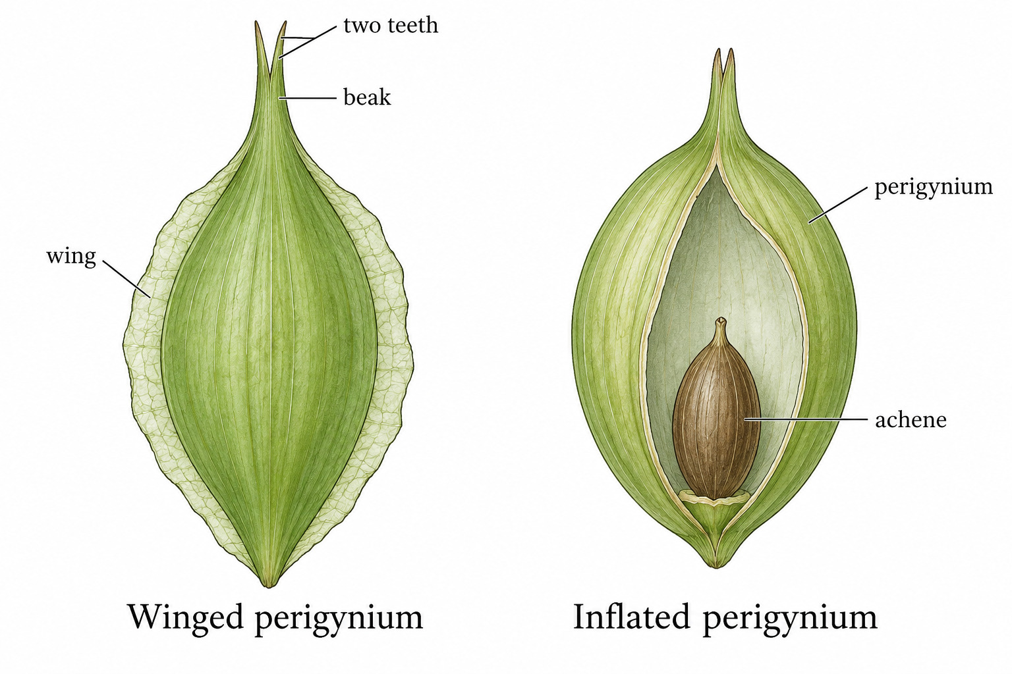
SEDGES
Winged and inflated perigynia
Winged Having a thin, expanded margin.
Inflated Expanded or bladderlike; a perigynium may fit loosely around its achene.
Winged perigynium; inflated perigynium shown in cutaway
33
Notes:
Winged: Having a thin, expanded margin. Inflated: Expanded or bladderlike; a perigynium may fit loosely around its achene. Teaching notes
The Carex example bears two stigma branches. The schematic shape pair shows two convex faces versus one flat and one convex face. Diagrammed textures are illustrative.
Illustration sources and attribution
AI-generated schematic.
https://efloras.org/florataxon.aspx?flora_id=1&taxon_id=105644
Core references
https://ncbg.unc.edu/research/unc-herbarium/floras/
https://www.iplant.cn/foc/pdf/Poaceae.pdf
https://herbarium.ncsu.edu/rare/carex.htm
https://herbarium.ncsu.edu/rushes/
https://vplants.org/portal/plants/glossary/index.php

Slide 34


SEDGES
Achene shapes and stigma branches
Lenticular Lens-shaped, with two convex faces.
Planoconvex Flat on one face and convex on the other.
Stigma branches The divisions of the pollen-receptive portion; their number is often diagnostic.
Lenticular and planoconvex
Two stigma branches above a Carex achene
34
Notes:
Lenticular: Lens-shaped, with two convex faces. Planoconvex: Flat on one face and convex on the other. Stigma branches: The divisions of the pollen-receptive portion; their number is often diagnostic. Teaching notes
The Carex example bears two stigma branches. The schematic shape pair shows two convex faces versus one flat and one convex face. Diagrammed textures are illustrative.
Illustration sources and attribution
AI-generated schematic, conceptual fruit shapes.
https://sweetgum.nybg.org/science/glossary/
Correll & Correll (1972), via Wikimedia Commons. Public-domain source per Commons.
https://commons.wikimedia.org/wiki/File:Carex_stipata_AWP-SW-260.png
Core references
https://ncbg.unc.edu/research/unc-herbarium/floras/
https://www.iplant.cn/foc/pdf/Poaceae.pdf
https://herbarium.ncsu.edu/rare/carex.htm
https://herbarium.ncsu.edu/rushes/
https://vplants.org/portal/plants/glossary/index.php

Slide 35

SEDGES
Carex: male and female flower order
Androgynous In Carex, a spike with male flowers toward the tip and female flowers below.
Gynecandrous A spike with female flowers toward the tip and male flowers below.
Androgynous and gynecandrous
35
Notes:
Androgynous: In Carex, a spike with male flowers toward the tip and female flowers below. Gynecandrous: A spike with female flowers toward the tip and male flowers below. Teaching notes
The page combines a Carex sex-order schematic with explicitly identified Scleria examples of sheath and branch structures. Avoid presenting all three as Carex.
Illustration sources and attribution
AI-generated schematic, reviewed for flower order.
https://herbarium.ncsu.edu/rare/carex.htm
Core references
https://ncbg.unc.edu/research/unc-herbarium/floras/
https://www.iplant.cn/foc/pdf/Poaceae.pdf
https://herbarium.ncsu.edu/rare/carex.htm
https://herbarium.ncsu.edu/rushes/
https://vplants.org/portal/plants/glossary/index.php

Slide 36


SEDGES
Sedge branch bases and sheath rims
Prophyll The first leaflike structure of a lateral shoot.
Cladoprophyll A prophyll surrounding the base of an inflorescence branch.
Contraligule A projection at the sheath rim opposite the leaf blade.
Scleria structural example: contraligule at CT
Scleria structural example: branch prophyll at BP
36
Notes:
Prophyll: The first leaflike structure of a lateral shoot. Cladoprophyll: A prophyll surrounding the base of an inflorescence branch. Contraligule: A projection at the sheath rim opposite the leaf blade. Teaching notes
The page combines a Carex sex-order schematic with explicitly identified Scleria examples of sheath and branch structures. Avoid presenting all three as Carex.
Illustration sources and attribution
Antônio E. da S. Rocha, Schneider et al. (2026), Fig. 2. CC BY 4.0.
https://doi.org/10.1590/1809-4392202502541
Amazonian Scleria occulta used as a structural example, not a southeastern species.
Antônio E. da S. Rocha, Schneider et al. (2026), Fig. 2. CC BY 4.0.
https://doi.org/10.1590/1809-4392202502541
Amazonian Scleria occulta. BP = branch prophyll, BB = branch bract, R = rachis. This is a general branch-prophyll example; the main sex-order schematic depicts Carex.
Core references
https://ncbg.unc.edu/research/unc-herbarium/floras/
https://www.iplant.cn/foc/pdf/Poaceae.pdf
https://herbarium.ncsu.edu/rare/carex.htm
https://herbarium.ncsu.edu/rushes/
https://vplants.org/portal/plants/glossary/index.php

Slide 37


SEDGES
Specialized sedge fruit structures
Perianth bristles Slender floral structures surrounding the fruit base in some sedges.
Tubercle In spikerushes and beaksedges, the enlarged style base remaining atop the achene.
Stylopodium An enlarged style base.
Tubercle above, bristles from the base
Hypogynium In Scleria, a hardened structure at the achene base, sometimes lobed.
Cupula In Scleria, a supporting cup beneath the hypogynium that remains after fruit separation.
Scleria structural example: hypogynium at H
37
Notes:
Perianth bristles: Slender floral structures surrounding the fruit base in some sedges. Tubercle: In spikerushes and beaksedges, the enlarged style base remaining atop the achene. Stylopodium: An enlarged style base. Hypogynium: In Scleria, a hardened structure at the achene base, sometimes lobed. Cupula: In Scleria, a supporting cup beneath the hypogynium that remains after fruit separation. Teaching notes
The tubercle is the enlarged persistent style base atop the Eleocharis achene. Scleria hypogynium is basal.
Illustration sources and attribution
Correll & Correll (1972), via Wikimedia Commons. Public-domain source per Commons.
https://commons.wikimedia.org/wiki/File:Eleocharis_tuberculosa_AWP-SW.png
Layla J. C. Schneider, Schneider et al. (2026), Fig. 3D. CC BY 4.0.
https://doi.org/10.1590/1809-4392202502541
Basal view of Amazonian Scleria occulta. Scale bar retained. The cupula is not separately visible here.
Core references
https://ncbg.unc.edu/research/unc-herbarium/floras/
https://www.iplant.cn/foc/pdf/Poaceae.pdf
https://herbarium.ncsu.edu/rare/carex.htm
https://herbarium.ncsu.edu/rushes/
https://vplants.org/portal/plants/glossary/index.php

Slide 38


RUSHES
A rush flower becomes a capsule
Perianth The floral envelope surrounding the reproductive organs.
Tepal A perianth segment when sepals and petals are not clearly differentiated.
Outer / inner tepals The two successive sets of tepals; rush flowers usually have three in each.
Six tepals around a rush flower
Perianth and reproductive organs
Bracteole A small bract closely associated with an individual flower.
Capsule A dry fruit that opens to release seeds.
Capsule surrounded by tepals
38
Notes:
Perianth: The floral envelope surrounding the reproductive organs. Tepal: A perianth segment when sepals and petals are not clearly differentiated. Outer / inner tepals: The two successive sets of tepals; rush flowers usually have three in each. Bracteole: A small bract closely associated with an individual flower. Capsule: A dry fruit that opens to release seeds. Teaching notes
Old plate contains both Juncus effusus and historical J. hostii. Visible footer labels A=effusus and B=hostii, opposite Commons metadata. Use generic rush captions. Six tepals = two whorls of three; bracteole is not separately emphasized in this image set.
Illustration sources and attribution
Otto Wilhelm Thomé (1885), Flora von Deutschland. Public domain, via Wikimedia Commons.
https://commons.wikimedia.org/wiki/File:Juncus_spp_107.jpg
Otto Wilhelm Thomé (1885), Flora von Deutschland. Public domain, via Wikimedia Commons.
https://commons.wikimedia.org/wiki/File:Juncus_spp_107.jpg
Lower crop stops before adjacent inflorescence. Two tiny bracts occur below each flower, but this crop does not isolate bracteoles for beginners.
Otto Wilhelm Thomé (1885), Flora von Deutschland. Public domain, via Wikimedia Commons.
https://commons.wikimedia.org/wiki/File:Juncus_spp_107.jpg
Core references
https://ncbg.unc.edu/research/unc-herbarium/floras/
https://www.iplant.cn/foc/pdf/Poaceae.pdf
https://herbarium.ncsu.edu/rare/carex.htm
https://herbarium.ncsu.edu/rushes/
https://vplants.org/portal/plants/glossary/index.php

Slide 39

RUSHES
Opening fruits and their valves
Dehiscent Opening naturally at maturity.
Indehiscent Remaining closed at maturity.
Valve One of the sections into which a capsule opens.
A dehiscent capsule opens into valves
39
Notes:
Dehiscent: Opening naturally at maturity. Indehiscent: Remaining closed at maturity. Valve: One of the sections into which a capsule opens. Teaching notes
The source capsule exposes its valves. The generated cross sections should distinguish spaces (locules) from walls (septa). For an indehiscent comparison, optionally repeat the prior achene crop explicitly for review.
Illustration sources and attribution
Otto Wilhelm Thomé (1885), Flora von Deutschland. Public domain, via Wikimedia Commons.
https://commons.wikimedia.org/wiki/File:Juncus_spp_107.jpg
Core references
https://ncbg.unc.edu/research/unc-herbarium/floras/
https://www.iplant.cn/foc/pdf/Poaceae.pdf
https://herbarium.ncsu.edu/rare/carex.htm
https://herbarium.ncsu.edu/rushes/
https://vplants.org/portal/plants/glossary/index.php

Slide 40

RUSHES
Chambers and internal partitions
Locule An internal chamber of an ovary or fruit.
Unilocular / trilocular One-chambered / three-chambered.
Septum An internal partition. Plural: septa.
Septate Divided by internal partitions.
Fruit chambers and the partitions of a rush leaf
40
Notes:
Locule: An internal chamber of an ovary or fruit. Unilocular / trilocular: One-chambered / three-chambered. Septum: An internal partition. Plural: septa. Septate: Divided by internal partitions. Teaching notes
The source capsule exposes its valves. The generated cross sections should distinguish spaces (locules) from walls (septa). For an indehiscent comparison, optionally repeat the prior achene crop explicitly for review.
Illustration sources and attribution
Generated educational schematic. Shape and proportions are illustrative.
Definitions from the preceding glossary, checked against the cited botanical references.
Core references
https://ncbg.unc.edu/research/unc-herbarium/floras/
https://www.iplant.cn/foc/pdf/Poaceae.pdf
https://herbarium.ncsu.edu/rare/carex.htm
https://herbarium.ncsu.edu/rushes/
https://vplants.org/portal/plants/glossary/index.php

Slide 41

RUSHES
Rush leaves and seeds
Nodulose-septate Having transverse internal partitions that produce a jointed or slightly knobby appearance.
Tailed seed A seed with an elongated appendage at one or both ends.
Partitions in a leaf; appendages on a seed
41
Notes:
Nodulose-septate: Having transverse internal partitions that produce a jointed or slightly knobby appearance. Tailed seed: A seed with an elongated appendage at one or both ends. Teaching notes
The erect green projection beyond the cluster is an involucral bract. Brown basal scalelike leaves illustrate cataphylls. The illustrations of the leaf interior and tailed seed are generalized, not necessarily Juncus effusus.
Illustration sources and attribution
Generated educational schematic. Shape and proportions are illustrative.
Definitions from the preceding glossary, checked against the cited botanical references.
Core references
https://ncbg.unc.edu/research/unc-herbarium/floras/
https://www.iplant.cn/foc/pdf/Poaceae.pdf
https://herbarium.ncsu.edu/rare/carex.htm
https://herbarium.ncsu.edu/rushes/
https://vplants.org/portal/plants/glossary/index.php

Slide 42



RUSHES
Rush bases and flowering clusters
Cataphyll A reduced, scalelike leaf, often chiefly a basal sheath.
Pseudolateral inflorescence An apparently side-borne cluster whose upright bract resembles a continuation of the stem.
Anthela A cymose inflorescence whose lateral branches overtop the shorter central axis.
Pseudolateral cluster and upright bract
Cataphylls at the shoot bases
Branching rush inflorescence
42
Notes:
Cataphyll: A reduced, scalelike leaf, often chiefly a basal sheath. Pseudolateral inflorescence: An apparently side-borne cluster whose upright bract resembles a continuation of the stem. Anthela: A cymose inflorescence whose lateral branches overtop the shorter central axis. Teaching notes
The erect green projection beyond the cluster is an involucral bract. Brown basal scalelike leaves illustrate cataphylls. The illustrations of the leaf interior and tailed seed are generalized, not necessarily Juncus effusus.
Illustration sources and attribution
Nikolaus Thomas Host (1801–1809), Icones et descriptiones Graminum austriacorum. Public domain, via BHL/Wikimedia Commons.
https://commons.wikimedia.org/wiki/File:Juncus_effusus_illustration_(01).jpg
Nikolaus Thomas Host (1801–1809), Icones et descriptiones Graminum austriacorum. Public domain, via BHL/Wikimedia Commons.
https://commons.wikimedia.org/wiki/File:Juncus_effusus_illustration_(01).jpg
Nikolaus Thomas Host (1801–1809), Icones et descriptiones Graminum austriacorum. Public domain, via BHL/Wikimedia Commons.
https://commons.wikimedia.org/wiki/File:Juncus_articulatus_illustration_(01).jpg
Historical plate labeled Juncus adscendens and indexed by Commons as J. articulatus. The cluster shows unequal branch lengths. If teaching the exact anthela architecture, a simplified schematic with main and lateral axes distinguished would be clearer.
Core references
https://ncbg.unc.edu/research/unc-herbarium/floras/
https://www.iplant.cn/foc/pdf/Poaceae.pdf
https://herbarium.ncsu.edu/rare/carex.htm
https://herbarium.ncsu.edu/rushes/
https://vplants.org/portal/plants/glossary/index.php

Slide 43

SHAPES
Slender shapes
Linear Long and narrow, with approximately parallel sides.
Filiform Threadlike.
Capillary Extremely slender, like a fine hair.
Setaceous Bristle-shaped.
Ensiform Sword-shaped.
Subulate Awl-shaped: narrow and tapering to a fine point.
Slender forms compared schematically
43
Notes:
Linear: Long and narrow, with approximately parallel sides. Filiform: Threadlike. Capillary: Extremely slender, like a fine hair. Setaceous: Bristle-shaped. Ensiform: Sword-shaped. Subulate: Awl-shaped: narrow and tapering to a fine point. Teaching notes
Schematic comparative forms; actual descriptive shape categories overlap.
Illustration sources and attribution
Generated educational schematic. Shape and proportions are illustrative.
Definitions from the preceding glossary, checked against the cited botanical references.
Core references
https://ncbg.unc.edu/research/unc-herbarium/floras/
https://www.iplant.cn/foc/pdf/Poaceae.pdf
https://herbarium.ncsu.edu/rare/carex.htm
https://herbarium.ncsu.edu/rushes/
https://vplants.org/portal/plants/glossary/index.php

Slide 44

SHAPES
Two-dimensional outlines
Lanceolate Lance-shaped, widest below the middle and tapering toward the tip.
Oblanceolate Widest above the middle and narrowing toward the base.
Ovate Egg-shaped in outline, wider toward the base.
Obovate Egg-shaped in outline, wider toward the tip.
Elliptic Oval, widest near the middle.
Oblong Longer than wide, with roughly parallel sides.
Orbicular Approximately circular in outline.
Lanceolate, oblanceolate, oblong, elliptic, ovate, and obovate outlines
44
Notes:
Lanceolate: Lance-shaped, widest below the middle and tapering toward the tip. Oblanceolate: Widest above the middle and narrowing toward the base. Ovate: Egg-shaped in outline, wider toward the base. Obovate: Egg-shaped in outline, wider toward the tip. Elliptic: Oval, widest near the middle. Oblong: Longer than wide, with roughly parallel sides. Orbicular: Approximately circular in outline. Teaching notes
Oval is also labeled in the source; the requested term elliptic has its own labeled example. The illustration focuses on the pictured examples. Related terms in the text may require examination of a different specimen.
Illustration sources and attribution
Illustrated Flora of North Central Texas, illustrated glossary; adapted from Mason (1957), ©1957 University of California Press. Cropped for study.
https://fwbg.org/wp-content/uploads/2025/04/FNCT_1353-1456-Appendices-Glossary.pdf
Core references
https://ncbg.unc.edu/research/unc-herbarium/floras/
https://www.iplant.cn/foc/pdf/Poaceae.pdf
https://herbarium.ncsu.edu/rare/carex.htm
https://herbarium.ncsu.edu/rushes/
https://vplants.org/portal/plants/glossary/index.php

Slide 45

SHAPES
Three-dimensional shapes
Ovoid Three-dimensionally egg-shaped, wider toward the base.
Obovoid Three-dimensionally egg-shaped, wider toward the tip.
Fusiform Spindle-shaped, narrowing toward both ends.
Gibbous Unequally swollen on one side.
Solid shapes compared
45
Notes:
Ovoid: Three-dimensionally egg-shaped, wider toward the base. Obovoid: Three-dimensionally egg-shaped, wider toward the tip. Fusiform: Spindle-shaped, narrowing toward both ends. Gibbous: Unequally swollen on one side. Teaching notes
The illustration focuses on the pictured examples. Related terms in the text may require examination of a different specimen.
Illustration sources and attribution
Generated educational schematic. Shape and proportions are illustrative.
Definitions from the preceding glossary, checked against the cited botanical references.
Core references
https://ncbg.unc.edu/research/unc-herbarium/floras/
https://www.iplant.cn/foc/pdf/Poaceae.pdf
https://herbarium.ncsu.edu/rare/carex.htm
https://herbarium.ncsu.edu/rushes/
https://vplants.org/portal/plants/glossary/index.php

Slide 46

SHAPES
Abrupt points at the apex
Mucronate Ending abruptly in a short, sharp point.
Apiculate Ending in a small, distinct point.
Cuspidate Ending in a relatively long, stiff, sharp point.
Mucronate and cuspidate apices
46
Notes:
Mucronate: Ending abruptly in a short, sharp point. Apiculate: Ending in a small, distinct point. Cuspidate: Ending in a relatively long, stiff, sharp point. Teaching notes
The illustration focuses on the pictured examples. Related terms in the text may require examination of a different specimen.
Illustration sources and attribution
Illustrated Flora of North Central Texas, illustrated glossary; adapted from Mason (1957), ©1957 University of California Press. Cropped for study.
https://fwbg.org/wp-content/uploads/2025/04/FNCT_1353-1456-Appendices-Glossary.pdf
Core references
https://ncbg.unc.edu/research/unc-herbarium/floras/
https://www.iplant.cn/foc/pdf/Poaceae.pdf
https://herbarium.ncsu.edu/rare/carex.htm
https://herbarium.ncsu.edu/rushes/
https://vplants.org/portal/plants/glossary/index.php

Slide 47

SHAPES
Tips and tapering
Acute Ending in a sharp angle.
Acuminate Tapering gradually into an elongated point.
Obtuse Blunt or broadly rounded at the tip.
Attenuate Gradually narrowing into a slender portion.
Truncate Ending abruptly, as though cut across.
Emarginate Having a notch at the tip.
Emarginate, truncate, obtuse, acute, and acuminate apices
47
Notes:
Acute: Ending in a sharp angle. Acuminate: Tapering gradually into an elongated point. Obtuse: Blunt or broadly rounded at the tip. Attenuate: Gradually narrowing into a slender portion. Truncate: Ending abruptly, as though cut across. Emarginate: Having a notch at the tip. Teaching notes
The atlas crop also includes retuse. It should not be relabeled as one of the requested terms. The illustration focuses on the pictured examples. Related terms in the text may require examination of a different specimen.
Illustration sources and attribution
Illustrated Flora of North Central Texas, illustrated glossary; adapted from Mason (1957), ©1957 University of California Press. Cropped for study.
https://fwbg.org/wp-content/uploads/2025/04/FNCT_1353-1456-Appendices-Glossary.pdf
Core references
https://ncbg.unc.edu/research/unc-herbarium/floras/
https://www.iplant.cn/foc/pdf/Poaceae.pdf
https://herbarium.ncsu.edu/rare/carex.htm
https://herbarium.ncsu.edu/rushes/
https://vplants.org/portal/plants/glossary/index.php

Slide 48

SURFACES AND TISSUES
Hairless to softly hairy
Glabrous Without hairs.
Glabrescent Becoming hairless with age.
Pubescent Hairy; sometimes used more narrowly for short, soft hairs.
Puberulent Minutely hairy.
Pilose Bearing relatively long, soft hairs.
Villous Bearing long, soft, shaggy hairs.
Hair presence, density and loss with age
48
Notes:
Glabrous: Without hairs. Glabrescent: Becoming hairless with age. Pubescent: Hairy; sometimes used more narrowly for short, soft hairs. Puberulent: Minutely hairy. Pilose: Bearing relatively long, soft hairs. Villous: Bearing long, soft, shaggy hairs. Teaching notes
Generated hair states supplement sourced pilose and villous examples. Young-to-older sequence explicitly shows loss of hairs.
Illustration sources and attribution
Generated educational schematic. Shape and proportions are illustrative.
Definitions from the preceding glossary, checked against the cited botanical references.
Core references
https://ncbg.unc.edu/research/unc-herbarium/floras/
https://www.iplant.cn/foc/pdf/Poaceae.pdf
https://herbarium.ncsu.edu/rare/carex.htm
https://herbarium.ncsu.edu/rushes/
https://vplants.org/portal/plants/glossary/index.php

Slide 49

SURFACES AND TISSUES
Coarse and bristly hairs
Hirsute Bearing coarse, relatively stiff hairs.
Hispid Bearing stiff, bristly hairs.
Hispid and hirsute examples, with related hair types
49
Notes:
Hirsute: Bearing coarse, relatively stiff hairs. Hispid: Bearing stiff, bristly hairs. Teaching notes
The historical plate includes intermediate categories. These are descriptive types without fixed numerical boundaries.
Illustration sources and attribution
Illustrated Flora of North Central Texas, illustrated glossary; adapted from Mason (1957), ©1957 University of California Press. Cropped for study.
https://fwbg.org/wp-content/uploads/2025/04/FNCT_1353-1456-Appendices-Glossary.pdf
Core references
https://ncbg.unc.edu/research/unc-herbarium/floras/
https://www.iplant.cn/foc/pdf/Poaceae.pdf
https://herbarium.ncsu.edu/rare/carex.htm
https://herbarium.ncsu.edu/rushes/
https://vplants.org/portal/plants/glossary/index.php

Slide 50

SURFACES AND TISSUES
Hairs pressed against the surface
Strigose Bearing stiff hairs lying close to the surface.
Sericeous Silky, with fine, usually appressed hairs.
Strigose and sericeous hairs
50
Notes:
Strigose: Bearing stiff hairs lying close to the surface. Sericeous: Silky, with fine, usually appressed hairs. Teaching notes
The historical plate includes intermediate categories. These are descriptive types without fixed numerical boundaries.
Illustration sources and attribution
Illustrated Flora of North Central Texas, illustrated glossary; adapted from Mason (1957), ©1957 University of California Press. Cropped for study.
https://fwbg.org/wp-content/uploads/2025/04/FNCT_1353-1456-Appendices-Glossary.pdf
Core references
https://ncbg.unc.edu/research/unc-herbarium/floras/
https://www.iplant.cn/foc/pdf/Poaceae.pdf
https://herbarium.ncsu.edu/rare/carex.htm
https://herbarium.ncsu.edu/rushes/
https://vplants.org/portal/plants/glossary/index.php

Slide 51

SURFACES AND TISSUES
Woolly and matted hairs
Tomentose Densely covered with matted hairs.
Lanate Woolly.
Lanate and tomentose examples
51
Notes:
Tomentose: Densely covered with matted hairs. Lanate: Woolly. Teaching notes
The historical plate includes intermediate categories. These are descriptive types without fixed numerical boundaries.
Illustration sources and attribution
Illustrated Flora of North Central Texas, illustrated glossary; adapted from Mason (1957), ©1957 University of California Press. Cropped for study.
https://fwbg.org/wp-content/uploads/2025/04/FNCT_1353-1456-Appendices-Glossary.pdf
Core references
https://ncbg.unc.edu/research/unc-herbarium/floras/
https://www.iplant.cn/foc/pdf/Poaceae.pdf
https://herbarium.ncsu.edu/rare/carex.htm
https://herbarium.ncsu.edu/rushes/
https://vplants.org/portal/plants/glossary/index.php

Slide 52

SURFACES AND TISSUES
Edges, bristles, feathers, and roughness
Ciliate Having hairs along an edge.
Ciliolate Having very small hairs along an edge.
Setose Bearing bristles.
Plumose Feathery.
Scabrous / scabrid Rough from small projections or stiff hairs.
Scaberulous Minutely rough.
Marginal hairs, bristles, plumes and roughness
52
Notes:
Ciliate: Having hairs along an edge. Ciliolate: Having very small hairs along an edge. Setose: Bearing bristles. Plumose: Feathery. Scabrous / scabrid: Rough from small projections or stiff hairs. Scaberulous: Minutely rough. Teaching notes
Schematic relative differences; roughness and hair descriptions can overlap in practice.
Illustration sources and attribution
Generated educational schematic. Shape and proportions are illustrative.
Definitions from the preceding glossary, checked against the cited botanical references.
Core references
https://ncbg.unc.edu/research/unc-herbarium/floras/
https://www.iplant.cn/foc/pdf/Poaceae.pdf
https://herbarium.ncsu.edu/rare/carex.htm
https://herbarium.ncsu.edu/rushes/
https://vplants.org/portal/plants/glossary/index.php

Slide 53

SURFACES AND TISSUES
Barbs: toward the tip or base
Antrorse Directed toward the tip.
Retrorse Directed toward the base.
Barbellate Bearing tiny barbs.
Both bristles are barbellate; their barbs point in opposite directions
53
Notes:
Antrorse: Directed toward the tip. Retrorse: Directed toward the base. Barbellate: Bearing tiny barbs. Teaching notes
Barbellate means bearing small barbs; no base-to-tip orientation is claimed for the source crop. The illustration focuses on the pictured examples. Related terms in the text may require examination of a different specimen.
Illustration sources and attribution
Generated educational schematic. Shape and proportions are illustrative.
Definitions from the preceding glossary, checked against the cited botanical references.
Core references
https://ncbg.unc.edu/research/unc-herbarium/floras/
https://www.iplant.cn/foc/pdf/Poaceae.pdf
https://herbarium.ncsu.edu/rare/carex.htm
https://herbarium.ncsu.edu/rushes/
https://vplants.org/portal/plants/glossary/index.php

Slide 54


SURFACES AND TISSUES
Wax and raised surface features
Glaucous Having a waxy bloom, often bluish or whitish.
Papillose Covered with tiny nipplelike projections.
Verrucose Warty.
Tuberculate Covered with small bumps.
Glaucous: a wax bloom with a wiped patch
Papillae, warts and bumps
54
Notes:
Glaucous: Having a waxy bloom, often bluish or whitish. Papillose: Covered with tiny nipplelike projections. Verrucose: Warty. Tuberculate: Covered with small bumps. Teaching notes
Barbellate means bearing small barbs; no base-to-tip orientation is claimed for the source crop. The illustration focuses on the pictured examples. Related terms in the text may require examination of a different specimen.
Illustration sources and attribution
Generated educational schematic. Shape and proportions are illustrative.
Definitions from the preceding glossary, checked against the cited botanical references.
Generated educational schematic. Shape and proportions are illustrative.
Definitions from the preceding glossary, checked against the cited botanical references.
Core references
https://ncbg.unc.edu/research/unc-herbarium/floras/
https://www.iplant.cn/foc/pdf/Poaceae.pdf
https://herbarium.ncsu.edu/rare/carex.htm
https://herbarium.ncsu.edu/rushes/
https://vplants.org/portal/plants/glossary/index.php

Slide 55


SURFACES AND TISSUES
Reading fruit surface patterns
Rugose Wrinkled.
Rugulose Finely wrinkled.
Reticulate Marked with a netlike pattern.
Cancellate Having a lattice-like pattern.
Rugose: coarse wrinkles
Alveolate Having small honeycomb-like depressions.
Striate Marked with fine, usually parallel lines.
Punctate Marked with tiny dots, pits, or translucent spots.
Rugulose, reticulate, alveolate, and striate patterns
55
Notes:
Rugose: Wrinkled. Rugulose: Finely wrinkled. Reticulate: Marked with a netlike pattern. Cancellate: Having a lattice-like pattern. Alveolate: Having small honeycomb-like depressions. Striate: Marked with fine, usually parallel lines. Punctate: Marked with tiny dots, pits, or translucent spots. Teaching notes
The illustration focuses on the pictured examples. Related terms in the text may require examination of a different specimen.
Illustration sources and attribution
AI-generated schematic for this study deck; not a specimen or species-identification image.
OpenAI ImageGen; generated for this deck
AI-generated schematic for this study deck; not a specimen or species-identification image.
OpenAI ImageGen; generated for this deck
Core references
https://ncbg.unc.edu/research/unc-herbarium/floras/
https://www.iplant.cn/foc/pdf/Poaceae.pdf
https://herbarium.ncsu.edu/rare/carex.htm
https://herbarium.ncsu.edu/rushes/
https://vplants.org/portal/plants/glossary/index.php

Slide 56

SURFACES AND TISSUES
Thin tissues
Hyaline Thin and translucent or nearly transparent.
Membranous Thin and flexible, like a membrane.
Scarious Thin, dry, and papery, commonly pale or translucent.
A thin, translucent membranous ligule
56
Notes:
Hyaline: Thin and translucent or nearly transparent. Membranous: Thin and flexible, like a membrane. Scarious: Thin, dry, and papery, commonly pale or translucent. Teaching notes
The source margin is labeled serrate, not serrulate. Treat it as a comparison explaining the fine-toothed form, not an exact serrulate example. The illustration focuses on the pictured examples. Related terms in the text may require examination of a different specimen.
Illustration sources and attribution
Stefan.Iefnaer; modified by Paleontological Research Institution; CC BY-SA 4.0. Cropped.
https://evolution.earthathome.org/grasses/morphology/
Core references
https://ncbg.unc.edu/research/unc-herbarium/floras/
https://www.iplant.cn/foc/pdf/Poaceae.pdf
https://herbarium.ncsu.edu/rare/carex.htm
https://herbarium.ncsu.edu/rushes/
https://vplants.org/portal/plants/glossary/index.php

Slide 57

SURFACES AND TISSUES
Margin shapes
Entire Having an unbroken, untoothed margin.
Serrulate Finely saw-toothed.
Lacerate Irregularly cut or torn-looking.
Margin types, including entire and serrate; serrulate means finely serrate
57
Notes:
Entire: Having an unbroken, untoothed margin. Serrulate: Finely saw-toothed. Lacerate: Irregularly cut or torn-looking. Teaching notes
The source margin is labeled serrate, not serrulate. Treat it as a comparison explaining the fine-toothed form, not an exact serrulate example. The illustration focuses on the pictured examples. Related terms in the text may require examination of a different specimen.
Illustration sources and attribution
Illustrated Flora of North Central Texas, illustrated glossary; adapted from Mason (1957), ©1957 University of California Press. Cropped for study.
https://fwbg.org/wp-content/uploads/2025/04/FNCT_1353-1456-Appendices-Glossary.pdf
Core references
https://ncbg.unc.edu/research/unc-herbarium/floras/
https://www.iplant.cn/foc/pdf/Poaceae.pdf
https://herbarium.ncsu.edu/rare/carex.htm
https://herbarium.ncsu.edu/rushes/
https://vplants.org/portal/plants/glossary/index.php

Slide 58


SURFACES AND TISSUES
Veins, persistence, and enlargement
Nerve A vein; three-nerved means having three veins.
Enervate / nerveless Without evident veins.
Persistent Remaining attached.
Caducous Falling off early.
Persistent parts remain attached
Deciduous Falling off at some stage.
Accrescent Enlarging after flowering.
Deciduous parts fall away
58
Notes:
Nerve: A vein; three-nerved means having three veins. Enervate / nerveless: Without evident veins. Persistent: Remaining attached. Caducous: Falling off early. Deciduous: Falling off at some stage. Accrescent: Enlarging after flowering. Teaching notes
Static source illustrations do not demonstrate persistence, abscission timing, or post-flowering enlargement. Do not infer veinlessness from unlabeled drawings. The illustration focuses on the pictured examples. Related terms in the text may require examination of a different specimen.
Illustration sources and attribution
Generated educational schematic. Shape and proportions are illustrative.
Definitions from the preceding glossary, checked against the cited botanical references.
Generated educational schematic. Shape and proportions are illustrative.
Definitions from the preceding glossary, checked against the cited botanical references.
Core references
https://ncbg.unc.edu/research/unc-herbarium/floras/
https://www.iplant.cn/foc/pdf/Poaceae.pdf
https://herbarium.ncsu.edu/rare/carex.htm
https://herbarium.ncsu.edu/rushes/
https://vplants.org/portal/plants/glossary/index.php

Slide 59
READING KEYS
Reading comparisons and qualifiers
Subequal Almost equal.
Equalling Reaching the same length as another structure.
Exceeding Extending beyond or being longer than another structure.
± More or less; approximately.
ca. Approximately.
sub- Usually somewhat, nearly, or slightly, as in subequal or subterete.
Lemma 4 mm Palea 4 mm
59
Notes:
Subequal: Almost equal. Equalling: Reaching the same length as another structure. Exceeding: Extending beyond or being longer than another structure. ±: More or less; approximately. ca.: Approximately. sub-: Usually somewhat, nearly, or slightly, as in subequal or subterete. Teaching notes
Illustration sources and attribution
Core references
https://ncbg.unc.edu/research/unc-herbarium/floras/
https://www.iplant.cn/foc/pdf/Poaceae.pdf
https://herbarium.ncsu.edu/rare/carex.htm
https://herbarium.ncsu.edu/rushes/
https://vplants.org/portal/plants/glossary/index.php

Slide 60
READING KEYS
Decode a botanical key
(2–)4–6(–8) Usually 4–6, with occasional extremes of 2 and 8.
s.l. / sensu lato In the broad sense of a taxon's definition.
s.s. / sensu stricto In the narrow sense.
Couplet The pair of contrasting choices in a dichotomous key.
Lead One of those choices.
Usually 4–6. Occasionally 2 or 8.
60
Notes:
(2–)4–6(–8): Usually 4–6, with occasional extremes of 2 and 8. s.l. / sensu lato: In the broad sense of a taxon's definition. s.s. / sensu stricto: In the narrow sense. Couplet: The pair of contrasting choices in a dichotomous key. Lead: One of those choices. Teaching notes
Illustration sources and attribution
Core references
https://ncbg.unc.edu/research/unc-herbarium/floras/
https://www.iplant.cn/foc/pdf/Poaceae.pdf
https://herbarium.ncsu.edu/rare/carex.htm
https://herbarium.ncsu.edu/rushes/
https://vplants.org/portal/plants/glossary/index.php

Slide 61
RECALL
Practice: a grass spikelet
Locate the two basal glumes.
Find the axis joining the florets.
Name the outer bract of each floret.
Answer on the next slide
61
Notes:
Locate the two basal glumes. Find the axis joining the florets. Name the outer bract of each floret.
Illustration sources and attribution
Stefan.Iefnaer, CC BY-SA 4.0; adapted by Paleontological Research Institution / Earth@Home. Crop adaptation remains CC BY-SA 4.0. https://evolution.earthathome.org/grasses/morphology/ — https://creativecommons.org/licenses/by-sa/4.0/
https://evolution.earthathome.org/grasses/morphology/
Unlabeled reverse view; shared scale bar omitted. Useful quiz panel beside the labeled view.
Core references
https://ncbg.unc.edu/research/unc-herbarium/floras/
https://www.iplant.cn/foc/pdf/Poaceae.pdf
https://herbarium.ncsu.edu/rare/carex.htm
https://herbarium.ncsu.edu/rushes/
https://vplants.org/portal/plants/glossary/index.php

Slide 62
RECALL
Answer: a grass spikelet
The basal pair are glumes.
The internal axis is the rachilla.
Each outer floret bract is a lemma.
62
Notes:
The basal pair are glumes. The internal axis is the rachilla. Each outer floret bract is a lemma.
Illustration sources and attribution
Core references
https://ncbg.unc.edu/research/unc-herbarium/floras/
https://www.iplant.cn/foc/pdf/Poaceae.pdf
https://herbarium.ncsu.edu/rare/carex.htm
https://herbarium.ncsu.edu/rushes/
https://vplants.org/portal/plants/glossary/index.php

Slide 63

RECALL
Practice: a sedge fruit
Name the outer envelope.
Name the fruit inside it.
What makes the envelope inflated?
Answer on the next slide
63
Notes:
Name the outer envelope. Name the fruit inside it. What makes the envelope inflated?
Illustration sources and attribution
Generated educational schematic. Shape and proportions are illustrative.
Definitions from the preceding glossary, checked against the cited botanical references.
Core references
https://ncbg.unc.edu/research/unc-herbarium/floras/
https://www.iplant.cn/foc/pdf/Poaceae.pdf
https://herbarium.ncsu.edu/rare/carex.htm
https://herbarium.ncsu.edu/rushes/
https://vplants.org/portal/plants/glossary/index.php

Slide 64
RECALL
Answer: a sedge fruit
The envelope is the perigynium.
The enclosed fruit is an achene.
The envelope has space around the smaller achene.
64
Notes:
The envelope is the perigynium. The enclosed fruit is an achene. The envelope has space around the smaller achene.
Illustration sources and attribution
Core references
https://ncbg.unc.edu/research/unc-herbarium/floras/
https://www.iplant.cn/foc/pdf/Poaceae.pdf
https://herbarium.ncsu.edu/rare/carex.htm
https://herbarium.ncsu.edu/rushes/
https://vplants.org/portal/plants/glossary/index.php

Slide 65

RECALL
Practice: a leaf cross section
How does this young blade fold?
Which surface lies inside the V?
How would a convolute blade differ?
Answer on the next slide
65
Notes:
How does this young blade fold? Which surface lies inside the V? How would a convolute blade differ?
Illustration sources and attribution
Generated educational schematic. Shape and proportions are illustrative.
Definitions from the preceding glossary, checked against the cited botanical references.
Core references
https://ncbg.unc.edu/research/unc-herbarium/floras/
https://www.iplant.cn/foc/pdf/Poaceae.pdf
https://herbarium.ncsu.edu/rare/carex.htm
https://herbarium.ncsu.edu/rushes/
https://vplants.org/portal/plants/glossary/index.php

Slide 66
RECALL
Answer: a leaf cross section
The blade is conduplicate.
Its adaxial surface lies inside the fold.
A convolute blade rolls with overlapping margins.
66
Notes:
The blade is conduplicate. Its adaxial surface lies inside the fold. A convolute blade rolls with overlapping margins.
Illustration sources and attribution
Core references
https://ncbg.unc.edu/research/unc-herbarium/floras/
https://www.iplant.cn/foc/pdf/Poaceae.pdf
https://herbarium.ncsu.edu/rare/carex.htm
https://herbarium.ncsu.edu/rushes/
https://vplants.org/portal/plants/glossary/index.php

Slide 67
SLIDE NUMBERS
Term index
(2–)4–6(–8)
60
Aristulate
23
±
59
Ascending
10
Abaxial
9
Attenuate
47
Accrescent
58
Auricle
5
Achene
31
Awn
23
Acuminate
47
Awn column
24
Acute
47
Axil
9
Adaxial
9
Axillary
9
Alveolate
55
Barbellate
53
Androgynous
35
Barren / neuter
30
Annual
7
Basal
8
Anthela
42
Beak / rostrum
32
Anther
28
Bidentate
32
Anthesis
30
Bisexual / perfect
29
Antrorse
53
Blade / lamina
5
Apiculate
46
Bladeless sheath
15
Appressed
10
Bract
16
Aristate
23
Bracteole
38
67
Notes:
Alphabetical index to the lesson slides. Synonyms grouped in the glossary appear together.
Illustration sources and attribution
Core references
https://ncbg.unc.edu/research/unc-herbarium/floras/
https://www.iplant.cn/foc/pdf/Poaceae.pdf
https://herbarium.ncsu.edu/rare/carex.htm
https://herbarium.ncsu.edu/rushes/
https://vplants.org/portal/plants/glossary/index.php

Slide 68
SLIDE NUMBERS
Term index
ca.
59
Closed sheath
15
Caducous
58
Collar
5
Caespitose / cespitose
7
Compressed
12
Callus
24
Conduplicate
13
Canaliculate
14
Congested
19
Cancellate
55
Contracted panicle
17
Capillary
43
Contraligule
36
Capitate
18
Convolute
13
Capsule
38
Coriaceous
26
Caryopsis / grain
22
Couplet
60
Cataphyll
42
Crown
4
Cauline
8
Culm
4
Chartaceous
26
Cupula
37
Chasmogamous
30
Cuspidate
46
Ciliate
52
Cyperaceae
3
Ciliolate
52
Deciduous
58
Cladoprophyll
36
Decumbent
11
Cleistogamous
30
Dehiscent
39
68
Notes:
Alphabetical index to the lesson slides. Synonyms grouped in the glossary appear together.
Illustration sources and attribution
Core references
https://ncbg.unc.edu/research/unc-herbarium/floras/
https://www.iplant.cn/foc/pdf/Poaceae.pdf
https://herbarium.ncsu.edu/rare/carex.htm
https://herbarium.ncsu.edu/rushes/
https://vplants.org/portal/plants/glossary/index.php

Slide 69
SLIDE NUMBERS
Term index
Digitate
18
Exserted
11
Dioecious
29
Fascicle
18
Disarticulating above the glumes
25
Fertile floret
30
Disarticulating below the glumes
25
Fibrous roots
6
Disarticulating between florets
25
Filament
28
Disarticulation
25
Filiform
43
Distal
8
Fistulose
14
Distichous / two-ranked
11
Floral scale
31
Dorsal awn
23
Floret
20
Dorsally compressed
26
Fusiform
45
Eligulate
15
Geniculate
24
Elliptic
44
Gibbous
45
Emarginate
47
Glabrescent
48
Enervate / nerveless
58
Glabrous
48
Ensiform
43
Glaucous
54
Entire
57
Glomerule
18
Equalling
59
Glumes
20
Exceeding
59
Graminoid
3
69
Notes:
Alphabetical index to the lesson slides. Synonyms grouped in the glossary appear together.
Illustration sources and attribution
Core references
https://ncbg.unc.edu/research/unc-herbarium/floras/
https://www.iplant.cn/foc/pdf/Poaceae.pdf
https://herbarium.ncsu.edu/rare/carex.htm
https://herbarium.ncsu.edu/rushes/
https://vplants.org/portal/plants/glossary/index.php

Slide 70
SLIDE NUMBERS
Term index
Gynecandrous
35
Involucral bract
19
Head / capitulum
18
Involucre
19
Heterogamous pair
27
Involute
13
Hilum
22
Juncaceae
3
Hirsute
49
Keeled / carinate
14
Hispid
49
Lacerate
57
Homogamous pair
27
Lanate
51
Hyaline
56
Lanceolate
44
Hypogynium
37
Lateral
8
Imbricate
11
Laterally compressed
26
Included
11
Lead
60
Indehiscent
39
Lemma
21
Indurate
26
Lenticular
34
Inflated
33
Ligulate
15
Inflorescence
16
Ligule
5
Innovation
4
Linear
43
Internode
4
Locule
40
Interrupted
19
Lodicules
22
70
Notes:
Alphabetical index to the lesson slides. Synonyms grouped in the glossary appear together.
Illustration sources and attribution
Core references
https://ncbg.unc.edu/research/unc-herbarium/floras/
https://www.iplant.cn/foc/pdf/Poaceae.pdf
https://herbarium.ncsu.edu/rare/carex.htm
https://herbarium.ncsu.edu/rushes/
https://vplants.org/portal/plants/glossary/index.php

Slide 71
SLIDE NUMBERS
Term index
Lower / first glume
20
Outer / inner tepals
38
Lower floret
22
Ovary
28
Membranous
56
Ovate
44
Monoecious
29
Ovoid
45
Mucronate
46
Palea
21
Muticous
23
Panicle
17
Nerve
58
Papillose
54
Node
4
Pedicel
16
Nodulose-septate
41
Pedicellate / pedicelled
9
Nutlet
31
Pedicellate spikelet
27
Oblanceolate
44
Peduncle
16
Oblong
44
Perennial
7
Obovate
44
Perianth
38
Obovoid
45
Perianth bristles
37
Obtuse
47
Perigynium
32
Open panicle
17
Perigynium body
32
Open sheath
15
Persistent
58
Orbicular
44
Pilose
48
71
Notes:
Alphabetical index to the lesson slides. Synonyms grouped in the glossary appear together.
Illustration sources and attribution
Core references
https://ncbg.unc.edu/research/unc-herbarium/floras/
https://www.iplant.cn/foc/pdf/Poaceae.pdf
https://herbarium.ncsu.edu/rare/carex.htm
https://herbarium.ncsu.edu/rushes/
https://vplants.org/portal/plants/glossary/index.php

Slide 72
SLIDE NUMBERS
Term index
Pistil
28
Rachis
16
Pistillate
29
Rame
27
Pistillate scale
31
Ray
19
Pith
14
Recurved
10
Planoconvex
34
Reflexed
10
Plicate
13
Reticulate
55
Plumose
52
Retrorse
53
Poaceae
3
Revolute
13
Prophyll
36
Rhizomatous
6
Prostrate
11
Rhizome
6
Proximal
8
Rostrate
32
Pseudolateral inflorescence
42
Rugose
55
Puberulent
48
Rugulose
55
Pubescent
48
s.l. / sensu lato
60
Punctate
55
s.s. / sensu stricto
60
Raceme
17
Scaberulous
52
Rachilla
22
Scabrous / scabrid
52
Rachilla extension
22
Scarious
56
72
Notes:
Alphabetical index to the lesson slides. Synonyms grouped in the glossary appear together.
Illustration sources and attribution
Core references
https://ncbg.unc.edu/research/unc-herbarium/floras/
https://www.iplant.cn/foc/pdf/Poaceae.pdf
https://herbarium.ncsu.edu/rare/carex.htm
https://herbarium.ncsu.edu/rushes/
https://vplants.org/portal/plants/glossary/index.php

Slide 73
SLIDE NUMBERS
Term index
Secund
18
Spreading / divergent
10
Sedge glume
31
Stamen
28
Semiterete
12
Staminate
29
Septate
40
Sterile
30
Septum
40
Stigma
28
Sericeous
50
Stigma branches
34
Serrulate
57
Stipitate
10
Sessile
9
Stolon
6
Sessile spikelet
27
Stoloniferous
6
Setaceous
43
Striate
55
Setose
52
Strigose
50
Sheath
5
Style
28
Simple / compound
19
Stylopodium
37
Spathe
27
sub-
59
Spatheole
27
Subdigitate
18
Spiciform
17
Subequal
59
Spike
17
Subtending
9
Spikelet
20
Subulate
43
73
Notes:
Alphabetical index to the lesson slides. Synonyms grouped in the glossary appear together.
Illustration sources and attribution
Core references
https://ncbg.unc.edu/research/unc-herbarium/floras/
https://www.iplant.cn/foc/pdf/Poaceae.pdf
https://herbarium.ncsu.edu/rare/carex.htm
https://herbarium.ncsu.edu/rushes/
https://vplants.org/portal/plants/glossary/index.php

Slide 74
SLIDE NUMBERS
Term index
Sulcate
14
Upper / second glume
20
Tailed seed
41
Upper floret
22
Tepal
38
Utricle
32
Terete
12
Valve
39
Terminal
8
Vegetative
7
Terminal awn
23
Vernation
15
Tiller
4
Verrucose
54
Tomentose
51
Villous
48
Trigonous
12
Winged
33
Triquetrous
12
Tristichous / three-ranked
11
Truncate
47
Tubercle
37
Tuberculate
54
Tussock
7
Umbel
19
Unilocular / trilocular
40
Unisexual
29
74
Notes:
Alphabetical index to the lesson slides. Synonyms grouped in the glossary appear together.
Illustration sources and attribution
Core references
https://ncbg.unc.edu/research/unc-herbarium/floras/
https://www.iplant.cn/foc/pdf/Poaceae.pdf
https://herbarium.ncsu.edu/rare/carex.htm
https://herbarium.ncsu.edu/rushes/
https://vplants.org/portal/plants/glossary/index.php

Slide 75
Botanical references
Weakley and the Southeastern Flora Team
Flora of the Southeastern United States.
https://ncbg.unc.edu/research/unc-herbarium/floras/
Grass structure
Paleontological Research Institution, Earth@Home.
https://evolution.earthathome.org/grasses/morphology/
Specialized grass vocabulary
Flora of China, Poaceae treatment and glossary.
https://www.iplant.cn/foc/pdf/Poaceae.pdf
Sedges and rushes
NC State Herbarium keys and Flora of North America treatments.
https://herbarium.ncsu.edu/rare/carex.htm
https://herbarium.ncsu.edu/rushes/
General terminology
vPlants glossary and Illustrated Flora of North Central Texas.
https://vplants.org/portal/plants/glossary/index.php
75
Notes:
Weakley and the Southeastern Flora Team
Flora of the Southeastern United States. https://ncbg.unc.edu/research/unc-herbarium/floras/
Grass structure
Paleontological Research Institution, Earth@Home. https://evolution.earthathome.org/grasses/morphology/
Specialized grass vocabulary
Flora of China, Poaceae treatment and glossary. https://www.iplant.cn/foc/pdf/Poaceae.pdf
Sedges and rushes
NC State Herbarium keys and Flora of North America treatments. https://herbarium.ncsu.edu/rare/carex.htm
https://herbarium.ncsu.edu/rushes/
General terminology
vPlants glossary and Illustrated Flora of North Central Texas. https://vplants.org/portal/plants/glossary/index.php
Illustration sources and attribution
Core references
https://ncbg.unc.edu/research/unc-herbarium/floras/
https://www.iplant.cn/foc/pdf/Poaceae.pdf
https://herbarium.ncsu.edu/rare/carex.htm
https://herbarium.ncsu.edu/rushes/
https://vplants.org/portal/plants/glossary/index.php

Slide 76
Illustration credits
Kelvinsong and Paleontological Research Institution: grass anatomy, CC BY 3.0.
Stefan.Iefnaer and Tim1357: grass photographs, CC BY-SA 4.0 / 2.0. Cropped adaptations retain the applicable image license.
D. M’Alpine (1882), H. Marshall Ward (1908), O. W. Thomé (1885) and N. T. Host (1801–1809): historical botanical illustrations.
Correll and Correll (1972): wetland plant plates. Source captions and credits accompany the relevant slides.
Illustrated Flora of North Central Texas: selected glossary details, adapted from Mason (1957), © University of California Press.
Schneider et al. (2026): Scleria structural examples, CC BY 4.0. The illustrated Amazonian species demonstrates shared organs.
New comparison illustrations: generated schematics for this study deck. They illustrate terms rather than identify species.
76
Notes:
O. W. Thomé (1885). Public domain. D. M’Alpine, The Botanical Atlas (1882), Plate IV. Public domain, via BHL / Wikimedia Commons. Otto Wilhelm Thomé (1885), Flora von Deutschland. Public domain, via Wikimedia Commons. https://commons.wikimedia.org/wiki/File:Juncus_spp_107.jpg
Kelvinsong, CC BY 3.0; adapted by Paleontological Research Institution / Earth@Home. Cropped from the provided image. https://evolution.earthathome.org/grasses/morphology/ — https://creativecommons.org/licenses/by/3.0/
https://evolution.earthathome.org/grasses/morphology/
Stefan.Iefnaer and Tim1357. CC BY-SA 4.0 / 2.0. Adapted by PRI. https://evolution.earthathome.org/grasses/morphology/
Kelvinsong, CC BY 3.0, adapted by PRI. https://evolution.earthathome.org/grasses/morphology/
Stefan.Iefnaer. CC BY-SA 4.0. Adapted by PRI. https://evolution.earthathome.org/grasses/morphology/
Generated educational schematic. Shape and proportions are illustrative. Definitions from the preceding glossary, checked against the cited botanical references. D. M’Alpine, The Botanical Atlas (1882), Plate IV, Grass and Sedge; scan via Biodiversity Heritage Library / Wikimedia Commons. Public domain. Cropped from the plate. https://commons.wikimedia.org/wiki/File:The_botanical_atlas_(Plate_IV)_(7349108122).jpg
https://commons.wikimedia.org/wiki/File:The_botanical_atlas_(Plate_IV)_(7349108122).jpg
H. Marshall Ward, Grasses (1908). Public domain. Illustrated Flora of North Central Texas, p. 1427; adapted from Mason (1957), © University of California Press
https://fwbg.org/wp-content/uploads/2025/04/FNCT_1353-1456-Appendices-Glossary.pdf
Parnell, in Ward, Grasses (1908), Fig. 5; public domain
https://www.gutenberg.org/files/47898/47898-h/47898-h.htm
Parnell, in Ward, Grasses (1908), Fig. 2; public domain
https://www.gutenberg.org/files/47898/47898-h/47898-h.htm
Stefan.Iefnaer, CC BY-SA 4.0; adapted by Paleontological Research Institution / Earth@Home. Crop adaptation remains CC BY-SA 4.0. https://evolution.earthathome.org/grasses/morphology/ — https://creativecommons.org/licenses/by-sa/4.0/
https://evolution.earthathome.org/grasses/morphology/
Stebler, in Ward, Grasses (1908), Fig. 71; public domain
https://www.gutenberg.org/files/47898/47898-h/47898-h.htm
Nobbe, in Ward, Grasses (1908), Fig. 69; public domain
https://www.gutenberg.org/files/47898/47898-h/47898-h.htm
Stefan.Iefnaer / Earth@Home, CC BY-SA 4.0; cropped
https://evolution.earthathome.org/grasses/morphology/
Correll & Correll (1972), via Wikimedia Commons. Public-domain source per Commons. https://commons.wikimedia.org/wiki/File:Eleocharis_flavescens_AWP-SW.png
Correll & Correll (1972), via Wikimedia Commons. Public-domain source per Commons. https://commons.wikimedia.org/wiki/File:Carex_stipata_AWP-SW-260.png
AI-generated schematic. https://efloras.org/florataxon.aspx?flora_id=1&taxon_id=105644
AI-generated schematic, conceptual fruit shapes. https://sweetgum.nybg.org/science/glossary/
AI-generated schematic, reviewed for flower order. https://herbarium.ncsu.edu/rare/carex.htm
Antônio E. da S. Rocha, Schneider et al. (2026), Fig. 2. CC BY 4.0. https://doi.org/10.1590/1809-4392202502541
Correll & Correll (1972), via Wikimedia Commons. Public-domain source per Commons. https://commons.wikimedia.org/wiki/File:Eleocharis_tuberculosa_AWP-SW.png
Layla J. C. Schneider, Schneider et al. (2026), Fig. 3D. CC BY 4.0. https://doi.org/10.1590/1809-4392202502541
Nikolaus Thomas Host (1801–1809), Icones et descriptiones Graminum austriacorum. Public domain, via BHL/Wikimedia Commons. https://commons.wikimedia.org/wiki/File:Juncus_effusus_illustration_(01).jpg
Nikolaus Thomas Host (1801–1809), Icones et descriptiones Graminum austriacorum. Public domain, via BHL/Wikimedia Commons. https://commons.wikimedia.org/wiki/File:Juncus_articulatus_illustration_(01).jpg
Illustrated Flora of North Central Texas, illustrated glossary; adapted from Mason (1957), ©1957 University of California Press. Cropped for study. https://fwbg.org/wp-content/uploads/2025/04/FNCT_1353-1456-Appendices-Glossary.pdf
AI-generated schematic for this study deck; not a specimen or species-identification image. OpenAI ImageGen; generated for this deck
Stefan.Iefnaer; modified by Paleontological Research Institution; CC BY-SA 4.0. Cropped. https://evolution.earthathome.org/grasses/morphology/
Illustration sources and attribution
Core references
https://ncbg.unc.edu/research/unc-herbarium/floras/
https://www.iplant.cn/foc/pdf/Poaceae.pdf
https://herbarium.ncsu.edu/rare/carex.htm
https://herbarium.ncsu.edu/rushes/
https://vplants.org/portal/plants/glossary/index.php

